Slide 1
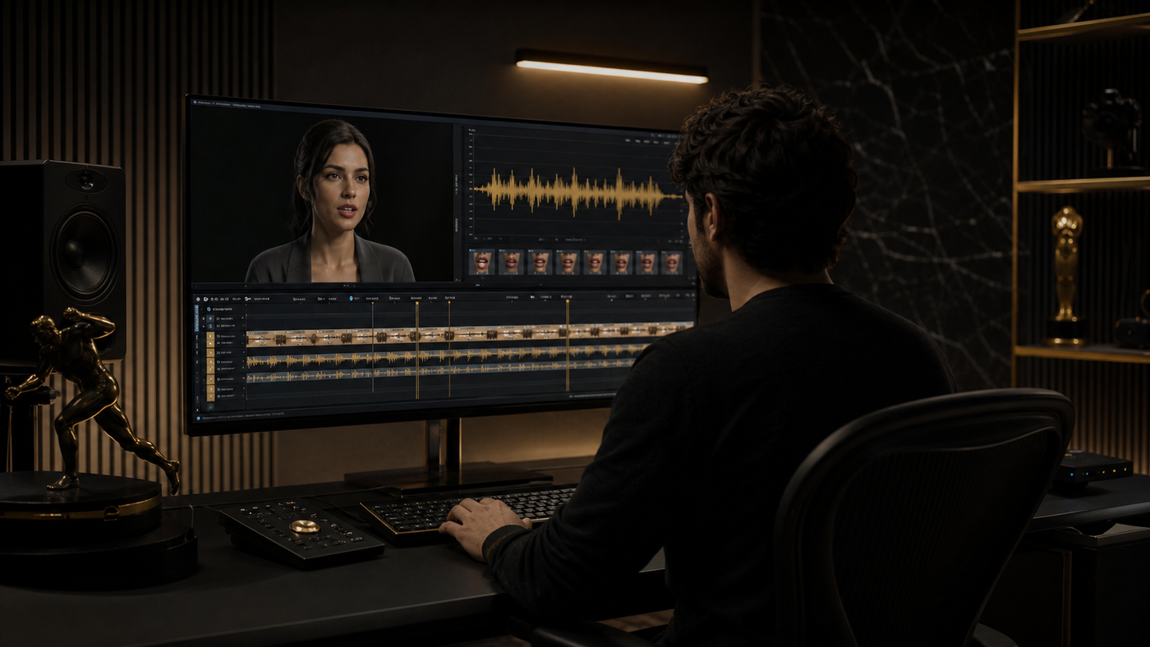
LipSyncX
AI lip sync for
YouTube
A localization workflow for videos with a
visible speaker
lipsync ai
01 / 08
Notes:
Source tutorial: https://lipsyncx.com/blog/ai-lip-sync-for-youtube
Original title: AI Lip Sync for YouTube: A Practical Localization Workflow for 2026
Author: LipSyncX Editorial Team
Source published: 2026-05-20T07:00:34.658Z
Reference links from the tutorial:
https://support.google.com/youtube/answer/13338784
https://blog.youtube/news-and-events/youtube-expands-auto-dubbing-for-creators/
https://lipsyncx.com/studio
https://lipsyncx.com/ai-video-dubbing
https://lipsyncx.com/pricing
Pricing, provider features and example settings retain the source article's dated context. Consult current provider documentation and the displayed generation quote for a new job.
Cover artwork: https://file.lipsyncx.com/blog-assets/ai-lip-sync-for-youtube/cover.png

Slide 2
The videos worth localizing
Strong candidates
Talking-head tutorials, product demos and explainers give lip
sync a visible job.
Lower priority
Screen recordings, slides and B-roll may need translated
captions or clean audio alone.
Pilot
Choose one video that already works with your audience and
one target language.
lipsync ai
02 / 08
Notes:
Source tutorial: https://lipsyncx.com/blog/ai-lip-sync-for-youtube
Original title: AI Lip Sync for YouTube: A Practical Localization Workflow for 2026
Author: LipSyncX Editorial Team
Source published: 2026-05-20T07:00:34.658Z
Reference links from the tutorial:
https://support.google.com/youtube/answer/13338784
https://blog.youtube/news-and-events/youtube-expands-auto-dubbing-for-creators/
https://lipsyncx.com/studio
https://lipsyncx.com/ai-video-dubbing
https://lipsyncx.com/pricing
Pricing, provider features and example settings retain the source article's dated context. Consult current provider documentation and the displayed generation quote for a new job.

Slide 3
Source video and spoken timing
Picture lock
Finish the source edit before translation and synchronization.
Keep the speaker’s mouth visible.
Translation
Rewrite long literal sentences as natural speech with usable
pauses.
Voice approval
Review names, pacing and emotional tone before generating
mouth movement.
lipsync ai
03 / 08
Notes:
Source tutorial: https://lipsyncx.com/blog/ai-lip-sync-for-youtube
Original title: AI Lip Sync for YouTube: A Practical Localization Workflow for 2026
Author: LipSyncX Editorial Team
Source published: 2026-05-20T07:00:34.658Z
Reference links from the tutorial:
https://support.google.com/youtube/answer/13338784
https://blog.youtube/news-and-events/youtube-expands-auto-dubbing-for-creators/
https://lipsyncx.com/studio
https://lipsyncx.com/ai-video-dubbing
https://lipsyncx.com/pricing
Pricing, provider features and example settings retain the source article's dated context. Consult current provider documentation and the displayed generation quote for a new job.

Slide 4
Three localization outputs
Output | Useful when | Main check
Subtitles | Text accessibility is enough | Reading speed and accuracy
Dubbed audio | Speech matters more than the face | Pronunciation and delivery
Lip-synced video | The speaker is prominent | Mouth timing and face stability
lipsync ai
04 / 08
Notes:
Source tutorial: https://lipsyncx.com/blog/ai-lip-sync-for-youtube
Original title: AI Lip Sync for YouTube: A Practical Localization Workflow for 2026
Author: LipSyncX Editorial Team
Source published: 2026-05-20T07:00:34.658Z
Reference links from the tutorial:
https://support.google.com/youtube/answer/13338784
https://blog.youtube/news-and-events/youtube-expands-auto-dubbing-for-creators/
https://lipsyncx.com/studio
https://lipsyncx.com/ai-video-dubbing
https://lipsyncx.com/pricing
Pricing, provider features and example settings retain the source article's dated context. Consult current provider documentation and the displayed generation quote for a new job.

Slide 5
One video and several audio tracks
Same picture
Eligible YouTube workflows can attach multiple audio tracks to
one upload. Confirm availability in your account.
Different picture
A localized visual lip-sync pass changes the video. Plan a
separate localized export when that picture is required.
Market adaptation
Different hooks, examples or on-screen text may also justify a
separate localized edit.
lipsync ai
05 / 08
Notes:
Source tutorial: https://lipsyncx.com/blog/ai-lip-sync-for-youtube
Original title: AI Lip Sync for YouTube: A Practical Localization Workflow for 2026
Author: LipSyncX Editorial Team
Source published: 2026-05-20T07:00:34.658Z
Reference links from the tutorial:
https://support.google.com/youtube/answer/13338784
https://blog.youtube/news-and-events/youtube-expands-auto-dubbing-for-creators/
https://lipsyncx.com/studio
https://lipsyncx.com/ai-video-dubbing
https://lipsyncx.com/pricing
Pricing, provider features and example settings retain the source article's dated context. Consult current provider documentation and the displayed generation quote for a new job.

Slide 6
Two review passes
Muted playback
Inspect pauses, mouth timing and face consistency without the
voice masking visual problems.
Playback with
sound
Check names, sentence endings and whether the voice suits the
channel.
Editorial decision
Fix awkward wording before spending another render on the
same script.
lipsync ai
06 / 08
Notes:
Source tutorial: https://lipsyncx.com/blog/ai-lip-sync-for-youtube
Original title: AI Lip Sync for YouTube: A Practical Localization Workflow for 2026
Author: LipSyncX Editorial Team
Source published: 2026-05-20T07:00:34.658Z
Reference links from the tutorial:
https://support.google.com/youtube/answer/13338784
https://blog.youtube/news-and-events/youtube-expands-auto-dubbing-for-creators/
https://lipsyncx.com/studio
https://lipsyncx.com/ai-video-dubbing
https://lipsyncx.com/pricing
Pricing, provider features and example settings retain the source article's dated context. Consult current provider documentation and the displayed generation quote for a new job.

Slide 7
The first channel test
Input
Use one stable speaker clip and an approved translated voice
track.
Production
Check the quote, create a short sample and approve it at the
intended viewing size.
Distribution
Package the correct audio or localized video output, then review
the published version.
lipsync ai
07 / 08
Notes:
Source tutorial: https://lipsyncx.com/blog/ai-lip-sync-for-youtube
Original title: AI Lip Sync for YouTube: A Practical Localization Workflow for 2026
Author: LipSyncX Editorial Team
Source published: 2026-05-20T07:00:34.658Z
Reference links from the tutorial:
https://support.google.com/youtube/answer/13338784
https://blog.youtube/news-and-events/youtube-expands-auto-dubbing-for-creators/
https://lipsyncx.com/studio
https://lipsyncx.com/ai-video-dubbing
https://lipsyncx.com/pricing
Pricing, provider features and example settings retain the source article's dated context. Consult current provider documentation and the displayed generation quote for a new job.

Slide 8
Your first short test
Use one clear input and one approved recording. Check the quote,
review a short result, then decide what to make next.
lipsync ai
https://lipsyncx.com/
Original blog tutorial
https://lipsyncx.com/blog/ai-lip-sync-for-youtube
lipsync ai
08 / 08
Notes:
Source tutorial: https://lipsyncx.com/blog/ai-lip-sync-for-youtube
Original title: AI Lip Sync for YouTube: A Practical Localization Workflow for 2026
Author: LipSyncX Editorial Team
Source published: 2026-05-20T07:00:34.658Z
Reference links from the tutorial:
https://support.google.com/youtube/answer/13338784
https://blog.youtube/news-and-events/youtube-expands-auto-dubbing-for-creators/
https://lipsyncx.com/studio
https://lipsyncx.com/ai-video-dubbing
https://lipsyncx.com/pricing
Pricing, provider features and example settings retain the source article's dated context. Consult current provider documentation and the displayed generation quote for a new job.

