Slide 1
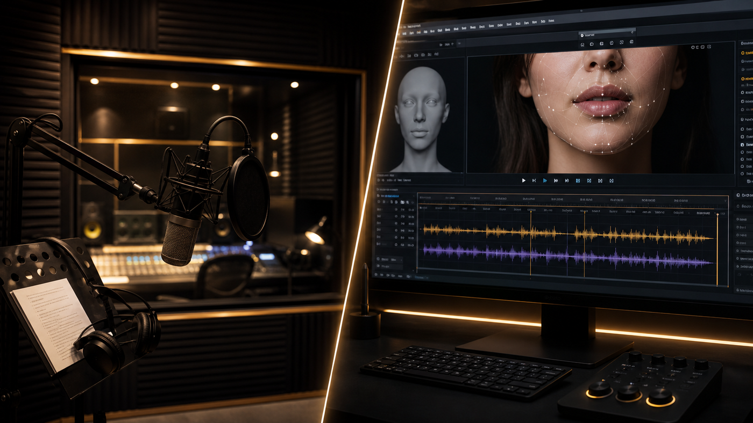
LipSyncX
AI lip sync or
manual dubbing?
A decision guide for performance,
revision effort and scale
lipsync ai
01 / 08
Notes:
Source tutorial: https://lipsyncx.com/blog/ai-lip-sync-vs-manual-dubbing
Original title: AI Lip Sync vs Manual Dubbing: Which Localization Workflow Holds Up in 2026?
Author: LipSyncX Editorial Team
Source published: 2026-05-20T07:27:09.372Z
Reference links from the tutorial:
https://support.google.com/youtube/answer/13338784
https://blog.youtube/news-and-events/youtube-auto-dubbing-expressive-speech/
https://github.com/Rudrabha/Wav2Lip
https://lipsyncx.com/studio
https://lipsyncx.com/ai-video-dubbing
https://lipsyncx.com/pricing
Pricing, provider features and example settings retain the source article's dated context. Consult current provider documentation and the displayed generation quote for a new job.
Cover artwork: https://file.lipsyncx.com/blog-assets/ai-lip-sync-vs-manual-dubbing/cover.png

Slide 2
The real production decision
Performance
Decide how much acting nuance and voice direction the video
requires.
Visibility
A large on-screen face makes mouth mismatch more noticeable.
Revisions
Compare the effort to reach approved quality after script
changes.
lipsync ai
02 / 08
Notes:
Source tutorial: https://lipsyncx.com/blog/ai-lip-sync-vs-manual-dubbing
Original title: AI Lip Sync vs Manual Dubbing: Which Localization Workflow Holds Up in 2026?
Author: LipSyncX Editorial Team
Source published: 2026-05-20T07:27:09.372Z
Reference links from the tutorial:
https://support.google.com/youtube/answer/13338784
https://blog.youtube/news-and-events/youtube-auto-dubbing-expressive-speech/
https://github.com/Rudrabha/Wav2Lip
https://lipsyncx.com/studio
https://lipsyncx.com/ai-video-dubbing
https://lipsyncx.com/pricing
Pricing, provider features and example settings retain the source article's dated context. Consult current provider documentation and the displayed generation quote for a new job.

Slide 3
The workflow tradeoffs
Dimension | Manual dubbing | AI lip sync
Performance | Direct voice-actor control | Model output needs review
Revisions | Recording and talent coordination | Software-based iteration
Scale | More coordination per language | Faster language pilots
Best use | Acting and sensitive delivery | Clear speaker-led information
lipsync ai
03 / 08
Notes:
Source tutorial: https://lipsyncx.com/blog/ai-lip-sync-vs-manual-dubbing
Original title: AI Lip Sync vs Manual Dubbing: Which Localization Workflow Holds Up in 2026?
Author: LipSyncX Editorial Team
Source published: 2026-05-20T07:27:09.372Z
Reference links from the tutorial:
https://support.google.com/youtube/answer/13338784
https://blog.youtube/news-and-events/youtube-auto-dubbing-expressive-speech/
https://github.com/Rudrabha/Wav2Lip
https://lipsyncx.com/studio
https://lipsyncx.com/ai-video-dubbing
https://lipsyncx.com/pricing
Pricing, provider features and example settings retain the source article's dated context. Consult current provider documentation and the displayed generation quote for a new job.

Slide 4
Manual dubbing scenarios
Brand films
A flagship launch or dramatic ad may need a supervised voice
performance.
Character work
Subtle hesitation, restraint or emotion can justify human
direction.
Production plan
Allow time for translation approval, talent, retakes and mixing.
lipsync ai
04 / 08
Notes:
Source tutorial: https://lipsyncx.com/blog/ai-lip-sync-vs-manual-dubbing
Original title: AI Lip Sync vs Manual Dubbing: Which Localization Workflow Holds Up in 2026?
Author: LipSyncX Editorial Team
Source published: 2026-05-20T07:27:09.372Z
Reference links from the tutorial:
https://support.google.com/youtube/answer/13338784
https://blog.youtube/news-and-events/youtube-auto-dubbing-expressive-speech/
https://github.com/Rudrabha/Wav2Lip
https://lipsyncx.com/studio
https://lipsyncx.com/ai-video-dubbing
https://lipsyncx.com/pricing
Pricing, provider features and example settings retain the source article's dated context. Consult current provider documentation and the displayed generation quote for a new job.

Slide 5
AI lip-sync scenarios
Repeated content
Tutorials, SaaS walkthroughs and demos often benefit from a
shorter review loop.
New languages
Test a representative clip before expanding a localization
program.
Usable footage
Favor visible mouths, stable lighting and a clear single speaker.
lipsync ai
05 / 08
Notes:
Source tutorial: https://lipsyncx.com/blog/ai-lip-sync-vs-manual-dubbing
Original title: AI Lip Sync vs Manual Dubbing: Which Localization Workflow Holds Up in 2026?
Author: LipSyncX Editorial Team
Source published: 2026-05-20T07:27:09.372Z
Reference links from the tutorial:
https://support.google.com/youtube/answer/13338784
https://blog.youtube/news-and-events/youtube-auto-dubbing-expressive-speech/
https://github.com/Rudrabha/Wav2Lip
https://lipsyncx.com/studio
https://lipsyncx.com/ai-video-dubbing
https://lipsyncx.com/pricing
Pricing, provider features and example settings retain the source article's dated context. Consult current provider documentation and the displayed generation quote for a new job.

Slide 6
A hybrid content library
Back catalog
Use reviewed AI versions for suitable informational content.
Hero assets
Reserve directed human dubbing for videos where performance
carries the message.
Escalation
Move a content category to a more controlled process if AI
results keep missing the standard.
lipsync ai
06 / 08
Notes:
Source tutorial: https://lipsyncx.com/blog/ai-lip-sync-vs-manual-dubbing
Original title: AI Lip Sync vs Manual Dubbing: Which Localization Workflow Holds Up in 2026?
Author: LipSyncX Editorial Team
Source published: 2026-05-20T07:27:09.372Z
Reference links from the tutorial:
https://support.google.com/youtube/answer/13338784
https://blog.youtube/news-and-events/youtube-auto-dubbing-expressive-speech/
https://github.com/Rudrabha/Wav2Lip
https://lipsyncx.com/studio
https://lipsyncx.com/ai-video-dubbing
https://lipsyncx.com/pricing
Pricing, provider features and example settings retain the source article's dated context. Consult current provider documentation and the displayed generation quote for a new job.

Slide 7
A fair comparison pilot
Same material
Use the same approved script and representative footage for
both paths.
Approval effort
Record reviewer time, revision cycles and the final usable
output.
Decision
Choose the process that meets this video’s quality standard
within the available budget.
lipsync ai
07 / 08
Notes:
Source tutorial: https://lipsyncx.com/blog/ai-lip-sync-vs-manual-dubbing
Original title: AI Lip Sync vs Manual Dubbing: Which Localization Workflow Holds Up in 2026?
Author: LipSyncX Editorial Team
Source published: 2026-05-20T07:27:09.372Z
Reference links from the tutorial:
https://support.google.com/youtube/answer/13338784
https://blog.youtube/news-and-events/youtube-auto-dubbing-expressive-speech/
https://github.com/Rudrabha/Wav2Lip
https://lipsyncx.com/studio
https://lipsyncx.com/ai-video-dubbing
https://lipsyncx.com/pricing
Pricing, provider features and example settings retain the source article's dated context. Consult current provider documentation and the displayed generation quote for a new job.

Slide 8
Your first short test
Use one clear input and one approved recording. Check the quote,
review a short result, then decide what to make next.
lipsync ai
https://lipsyncx.com/
Original blog tutorial
https://lipsyncx.com/blog/ai-lip-sync-vs-manual-dubbing
lipsync ai
08 / 08
Notes:
Source tutorial: https://lipsyncx.com/blog/ai-lip-sync-vs-manual-dubbing
Original title: AI Lip Sync vs Manual Dubbing: Which Localization Workflow Holds Up in 2026?
Author: LipSyncX Editorial Team
Source published: 2026-05-20T07:27:09.372Z
Reference links from the tutorial:
https://support.google.com/youtube/answer/13338784
https://blog.youtube/news-and-events/youtube-auto-dubbing-expressive-speech/
https://github.com/Rudrabha/Wav2Lip
https://lipsyncx.com/studio
https://lipsyncx.com/ai-video-dubbing
https://lipsyncx.com/pricing
Pricing, provider features and example settings retain the source article's dated context. Consult current provider documentation and the displayed generation quote for a new job.

