Slide 1
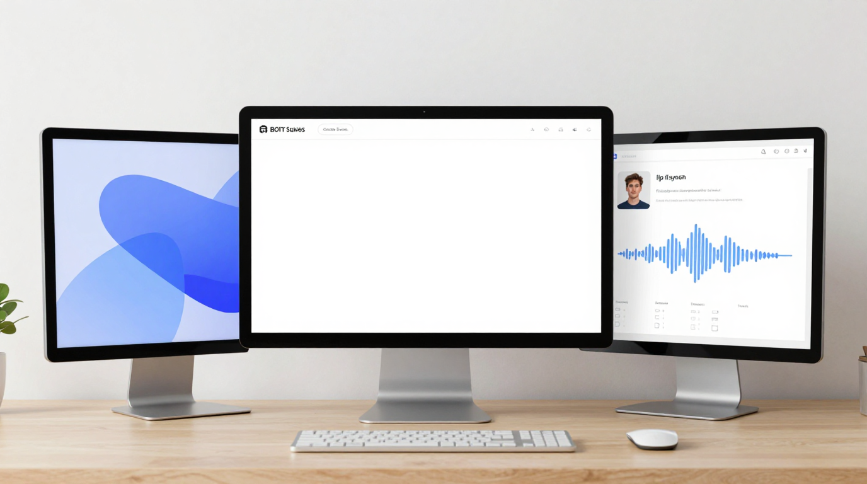
LipSyncX
Choosing an AI
lip-sync tool
A workflow comparison based on the
blog’s 2026 guide
lipsync ai
01 / 08
Notes:
Source tutorial: https://lipsyncx.com/blog/best-ai-lip-sync-tools-2026
Original title: Best AI Lip Sync Tools in 2026: Complete Guide to Automatic Video Lip Syncing
Author: LipSyncX Team
Source published: 2026-03-06T03:48:31.067Z
Reference links from the tutorial:
https://file.celebrityai.club/blog-images/aabed887-49f8-453a-982b-79fd8ee2daf0.webp
https://file.celebrityai.club/blog-images/5806ea53-07b1-4e72-ac8d-2225df06489d.webp
Pricing, provider features and example settings retain the source article's dated context. Consult current provider documentation and the displayed generation quote for a new job.
Cover artwork: https://file.celebrityai.club/blog-images/aabed887-49f8-453a-982b-79fd8ee2daf0.webp

Slide 2
The job behind the tool search
Talking photo
A portrait and voice track become a presenter clip.
Video localization
New speech needs to work with a visible speaker.
Production fit
Technical skills, review needs and output volume shape the
shortlist.
lipsync ai
02 / 08
Notes:
Source tutorial: https://lipsyncx.com/blog/best-ai-lip-sync-tools-2026
Original title: Best AI Lip Sync Tools in 2026: Complete Guide to Automatic Video Lip Syncing
Author: LipSyncX Team
Source published: 2026-03-06T03:48:31.067Z
Reference links from the tutorial:
https://file.celebrityai.club/blog-images/aabed887-49f8-453a-982b-79fd8ee2daf0.webp
https://file.celebrityai.club/blog-images/5806ea53-07b1-4e72-ac8d-2225df06489d.webp
Pricing, provider features and example settings retain the source article's dated context. Consult current provider documentation and the displayed generation quote for a new job.

Slide 3
Three paths in the source guide
Path | Workflow focus | Evaluation question
LipSyncX | Browser-based talking-video production | Does my own input reach usable quality?
HeyGen | Avatar and business-presenter workflows | Does the platform fit the team’s job?
Wav2Lip | A technical lip-sync baseline | Can we handle setup and verify the license?
lipsync ai
03 / 08
Notes:
Source tutorial: https://lipsyncx.com/blog/best-ai-lip-sync-tools-2026
Original title: Best AI Lip Sync Tools in 2026: Complete Guide to Automatic Video Lip Syncing
Author: LipSyncX Team
Source published: 2026-03-06T03:48:31.067Z
Reference links from the tutorial:
https://file.celebrityai.club/blog-images/aabed887-49f8-453a-982b-79fd8ee2daf0.webp
https://file.celebrityai.club/blog-images/5806ea53-07b1-4e72-ac8d-2225df06489d.webp
Pricing, provider features and example settings retain the source article's dated context. Consult current provider documentation and the displayed generation quote for a new job.

Slide 4
The representative test
Real materials
Use your own portrait or speaker clip with a clean, approved
recording.
Matched settings
Compare the same duration and resolution wherever possible.
Revision test
Change one line and repeat the review before committing to a
production process.
lipsync ai
04 / 08
Notes:
Source tutorial: https://lipsyncx.com/blog/best-ai-lip-sync-tools-2026
Original title: Best AI Lip Sync Tools in 2026: Complete Guide to Automatic Video Lip Syncing
Author: LipSyncX Team
Source published: 2026-03-06T03:48:31.067Z
Reference links from the tutorial:
https://file.celebrityai.club/blog-images/aabed887-49f8-453a-982b-79fd8ee2daf0.webp
https://file.celebrityai.club/blog-images/5806ea53-07b1-4e72-ac8d-2225df06489d.webp
Pricing, provider features and example settings retain the source article's dated context. Consult current provider documentation and the displayed generation quote for a new job.

Slide 5
The quality scorecard
Synchronization
Check stressed sounds, lip closures and sentence endings.
Visual stability
Watch the teeth, jaw, face identity and background.
Viewer experience
Judge expression and delivery at the intended playback size.
lipsync ai
05 / 08
Notes:
Source tutorial: https://lipsyncx.com/blog/best-ai-lip-sync-tools-2026
Original title: Best AI Lip Sync Tools in 2026: Complete Guide to Automatic Video Lip Syncing
Author: LipSyncX Team
Source published: 2026-03-06T03:48:31.067Z
Reference links from the tutorial:
https://file.celebrityai.club/blog-images/aabed887-49f8-453a-982b-79fd8ee2daf0.webp
https://file.celebrityai.club/blog-images/5806ea53-07b1-4e72-ac8d-2225df06489d.webp
Pricing, provider features and example settings retain the source article's dated context. Consult current provider documentation and the displayed generation quote for a new job.

Slide 6
The operating-cost scorecard
Actual quote
Compare the cost of a matching output rather than the number
of credits in a pack.
Total effort
Include setup, infrastructure, rerenders and reviewer time.
Commercial
conditions
Verify the current license, export rights and watermark rules for
the selected feature.
lipsync ai
06 / 08
Notes:
Source tutorial: https://lipsyncx.com/blog/best-ai-lip-sync-tools-2026
Original title: Best AI Lip Sync Tools in 2026: Complete Guide to Automatic Video Lip Syncing
Author: LipSyncX Team
Source published: 2026-03-06T03:48:31.067Z
Reference links from the tutorial:
https://file.celebrityai.club/blog-images/aabed887-49f8-453a-982b-79fd8ee2daf0.webp
https://file.celebrityai.club/blog-images/5806ea53-07b1-4e72-ac8d-2225df06489d.webp
Pricing, provider features and example settings retain the source article's dated context. Consult current provider documentation and the displayed generation quote for a new job.

Slide 7
The final selection
Occasional work
Choose a purchase model that fits the number of usable clips
you need.
Repeated work
Check whether the review and export process remains
manageable across a batch.
Source context
The blog’s older price and feature table is a historical snapshot.
Confirm current terms before purchase.
lipsync ai
07 / 08
Notes:
Source tutorial: https://lipsyncx.com/blog/best-ai-lip-sync-tools-2026
Original title: Best AI Lip Sync Tools in 2026: Complete Guide to Automatic Video Lip Syncing
Author: LipSyncX Team
Source published: 2026-03-06T03:48:31.067Z
Reference links from the tutorial:
https://file.celebrityai.club/blog-images/aabed887-49f8-453a-982b-79fd8ee2daf0.webp
https://file.celebrityai.club/blog-images/5806ea53-07b1-4e72-ac8d-2225df06489d.webp
Pricing, provider features and example settings retain the source article's dated context. Consult current provider documentation and the displayed generation quote for a new job.

Slide 8
Your first short test
Use one clear input and one approved recording. Check the quote,
review a short result, then decide what to make next.
lipsync ai
https://lipsyncx.com/
Original blog tutorial
https://lipsyncx.com/blog/best-ai-lip-sync-tools-2026
lipsync ai
08 / 08
Notes:
Source tutorial: https://lipsyncx.com/blog/best-ai-lip-sync-tools-2026
Original title: Best AI Lip Sync Tools in 2026: Complete Guide to Automatic Video Lip Syncing
Author: LipSyncX Team
Source published: 2026-03-06T03:48:31.067Z
Reference links from the tutorial:
https://file.celebrityai.club/blog-images/aabed887-49f8-453a-982b-79fd8ee2daf0.webp
https://file.celebrityai.club/blog-images/5806ea53-07b1-4e72-ac8d-2225df06489d.webp
Pricing, provider features and example settings retain the source article's dated context. Consult current provider documentation and the displayed generation quote for a new job.

