Slide 1
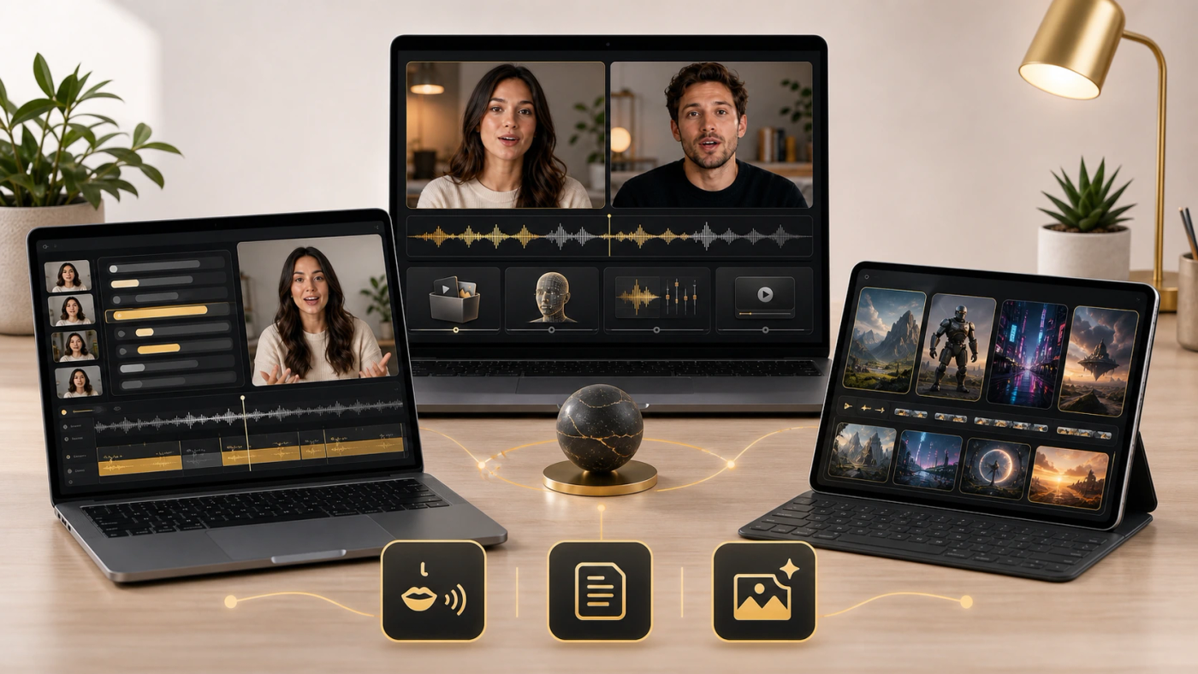
LipSyncX
Choosing a VEED
alternative
A guide organized around the video task
you repeat
lipsync ai
01 / 08
Notes:
Source tutorial: https://lipsyncx.com/blog/best-veed-io-alternatives-2026
Original title: Best VEED.IO Alternatives in 2026: Which Video Workflow Fits Better?
Author: LipSyncX Editorial Team
Source published: 2026-05-20T08:26:57.265Z
Reference links from the tutorial:
https://file.lipsyncx.com/blog-assets/best-veed-io-alternatives-2026/body-workflow.webp
https://www.veed.io/tools/voice-dubber/ai-video-localization
https://www.heygen.com/en-gb/translate
https://help.descript.com/hc/en-us/articles/37202655823629-Translate-and-dub-speech-overview
https://www.capcut.com/tools/video-translator
https://lipsyncx.com/studio
https://lipsyncx.com/ai-video-dubbing
https://file.lipsyncx.com/blog-assets/best-veed-io-alternatives-2026/body-comparison.webp
Pricing, provider features and example settings retain the source article's dated context. Consult current provider documentation and the displayed generation quote for a new job.
Cover artwork: https://file.lipsyncx.com/blog-assets/best-veed-io-alternatives-2026/cover.webp

Slide 2
The bottleneck comes first
Speaker realism
A close-up presenter may need dedicated mouth
synchronization.
Creation
A new scene needs a generation workflow.
Editing
Transcript revisions and caption publishing call for different
controls.
lipsync ai
02 / 08
Notes:
Source tutorial: https://lipsyncx.com/blog/best-veed-io-alternatives-2026
Original title: Best VEED.IO Alternatives in 2026: Which Video Workflow Fits Better?
Author: LipSyncX Editorial Team
Source published: 2026-05-20T08:26:57.265Z
Reference links from the tutorial:
https://file.lipsyncx.com/blog-assets/best-veed-io-alternatives-2026/body-workflow.webp
https://www.veed.io/tools/voice-dubber/ai-video-localization
https://www.heygen.com/en-gb/translate
https://help.descript.com/hc/en-us/articles/37202655823629-Translate-and-dub-speech-overview
https://www.capcut.com/tools/video-translator
https://lipsyncx.com/studio
https://lipsyncx.com/ai-video-dubbing
https://file.lipsyncx.com/blog-assets/best-veed-io-alternatives-2026/body-comparison.webp
Pricing, provider features and example settings retain the source article's dated context. Consult current provider documentation and the displayed generation quote for a new job.

Slide 3
The source guide’s shortlist
Tool | Job to evaluate
LipSyncX | Speaker-led localization and lip sync
Runway | AI-generated scenes and creative motion
HeyGen | Browser-based avatars and translation
Descript | Transcript-led spoken editing
CapCut | Fast social editing and subtitle workflows
lipsync ai
03 / 08
Notes:
Source tutorial: https://lipsyncx.com/blog/best-veed-io-alternatives-2026
Original title: Best VEED.IO Alternatives in 2026: Which Video Workflow Fits Better?
Author: LipSyncX Editorial Team
Source published: 2026-05-20T08:26:57.265Z
Reference links from the tutorial:
https://file.lipsyncx.com/blog-assets/best-veed-io-alternatives-2026/body-workflow.webp
https://www.veed.io/tools/voice-dubber/ai-video-localization
https://www.heygen.com/en-gb/translate
https://help.descript.com/hc/en-us/articles/37202655823629-Translate-and-dub-speech-overview
https://www.capcut.com/tools/video-translator
https://lipsyncx.com/studio
https://lipsyncx.com/ai-video-dubbing
https://file.lipsyncx.com/blog-assets/best-veed-io-alternatives-2026/body-comparison.webp
Pricing, provider features and example settings retain the source article's dated context. Consult current provider documentation and the displayed generation quote for a new job.

Slide 4
The visible-speaker test
Representative
footage
Use a tutorial, founder clip or product demo where the face stays
prominent.
LipSyncX pilot
Check the quote and render a short sample with the final audio.
Approval standard
Compare mouth realism and the effort needed to review another
version.
lipsync ai
04 / 08
Notes:
Source tutorial: https://lipsyncx.com/blog/best-veed-io-alternatives-2026
Original title: Best VEED.IO Alternatives in 2026: Which Video Workflow Fits Better?
Author: LipSyncX Editorial Team
Source published: 2026-05-20T08:26:57.265Z
Reference links from the tutorial:
https://file.lipsyncx.com/blog-assets/best-veed-io-alternatives-2026/body-workflow.webp
https://www.veed.io/tools/voice-dubber/ai-video-localization
https://www.heygen.com/en-gb/translate
https://help.descript.com/hc/en-us/articles/37202655823629-Translate-and-dub-speech-overview
https://www.capcut.com/tools/video-translator
https://lipsyncx.com/studio
https://lipsyncx.com/ai-video-dubbing
https://file.lipsyncx.com/blog-assets/best-veed-io-alternatives-2026/body-comparison.webp
Pricing, provider features and example settings retain the source article's dated context. Consult current provider documentation and the displayed generation quote for a new job.

Slide 5
The other workflow paths
Scene generation
Evaluate a generation tool when the missing asset is the picture
itself.
Transcript editing
Evaluate a spoken-content editor when word changes drive the
work.
Subtitles
Use a caption-focused workflow when the face is secondary.
lipsync ai
05 / 08
Notes:
Source tutorial: https://lipsyncx.com/blog/best-veed-io-alternatives-2026
Original title: Best VEED.IO Alternatives in 2026: Which Video Workflow Fits Better?
Author: LipSyncX Editorial Team
Source published: 2026-05-20T08:26:57.265Z
Reference links from the tutorial:
https://file.lipsyncx.com/blog-assets/best-veed-io-alternatives-2026/body-workflow.webp
https://www.veed.io/tools/voice-dubber/ai-video-localization
https://www.heygen.com/en-gb/translate
https://help.descript.com/hc/en-us/articles/37202655823629-Translate-and-dub-speech-overview
https://www.capcut.com/tools/video-translator
https://lipsyncx.com/studio
https://lipsyncx.com/ai-video-dubbing
https://file.lipsyncx.com/blog-assets/best-veed-io-alternatives-2026/body-comparison.webp
Pricing, provider features and example settings retain the source article's dated context. Consult current provider documentation and the displayed generation quote for a new job.

Slide 6
When the current editor still fits
Broad browser
editing
A mixed workflow may benefit from one familiar editor.
Accessibility
Subtitles can matter more than a synchronized close-up.
Switching
threshold
Change tools when a specific recurring task fails the team’s
quality or effort standard.
lipsync ai
06 / 08
Notes:
Source tutorial: https://lipsyncx.com/blog/best-veed-io-alternatives-2026
Original title: Best VEED.IO Alternatives in 2026: Which Video Workflow Fits Better?
Author: LipSyncX Editorial Team
Source published: 2026-05-20T08:26:57.265Z
Reference links from the tutorial:
https://file.lipsyncx.com/blog-assets/best-veed-io-alternatives-2026/body-workflow.webp
https://www.veed.io/tools/voice-dubber/ai-video-localization
https://www.heygen.com/en-gb/translate
https://help.descript.com/hc/en-us/articles/37202655823629-Translate-and-dub-speech-overview
https://www.capcut.com/tools/video-translator
https://lipsyncx.com/studio
https://lipsyncx.com/ai-video-dubbing
https://file.lipsyncx.com/blog-assets/best-veed-io-alternatives-2026/body-comparison.webp
Pricing, provider features and example settings retain the source article's dated context. Consult current provider documentation and the displayed generation quote for a new job.

Slide 7
The one-clip comparison
Hold inputs fixed
Use the same source, approved speech and intended export.
Record the loop
Count revisions, review effort and cost per usable output.
Current plans
Confirm feature access and pricing rather than relying on the
article’s dated snapshot.
lipsync ai
07 / 08
Notes:
Source tutorial: https://lipsyncx.com/blog/best-veed-io-alternatives-2026
Original title: Best VEED.IO Alternatives in 2026: Which Video Workflow Fits Better?
Author: LipSyncX Editorial Team
Source published: 2026-05-20T08:26:57.265Z
Reference links from the tutorial:
https://file.lipsyncx.com/blog-assets/best-veed-io-alternatives-2026/body-workflow.webp
https://www.veed.io/tools/voice-dubber/ai-video-localization
https://www.heygen.com/en-gb/translate
https://help.descript.com/hc/en-us/articles/37202655823629-Translate-and-dub-speech-overview
https://www.capcut.com/tools/video-translator
https://lipsyncx.com/studio
https://lipsyncx.com/ai-video-dubbing
https://file.lipsyncx.com/blog-assets/best-veed-io-alternatives-2026/body-comparison.webp
Pricing, provider features and example settings retain the source article's dated context. Consult current provider documentation and the displayed generation quote for a new job.

Slide 8
Your first short test
Use one clear input and one approved recording. Check the quote,
review a short result, then decide what to make next.
lipsync ai
https://lipsyncx.com/
Original blog tutorial
https://lipsyncx.com/blog/best-veed-io-alternatives-2026
lipsync ai
08 / 08
Notes:
Source tutorial: https://lipsyncx.com/blog/best-veed-io-alternatives-2026
Original title: Best VEED.IO Alternatives in 2026: Which Video Workflow Fits Better?
Author: LipSyncX Editorial Team
Source published: 2026-05-20T08:26:57.265Z
Reference links from the tutorial:
https://file.lipsyncx.com/blog-assets/best-veed-io-alternatives-2026/body-workflow.webp
https://www.veed.io/tools/voice-dubber/ai-video-localization
https://www.heygen.com/en-gb/translate
https://help.descript.com/hc/en-us/articles/37202655823629-Translate-and-dub-speech-overview
https://www.capcut.com/tools/video-translator
https://lipsyncx.com/studio
https://lipsyncx.com/ai-video-dubbing
https://file.lipsyncx.com/blog-assets/best-veed-io-alternatives-2026/body-comparison.webp
Pricing, provider features and example settings retain the source article's dated context. Consult current provider documentation and the displayed generation quote for a new job.

