Slide 1
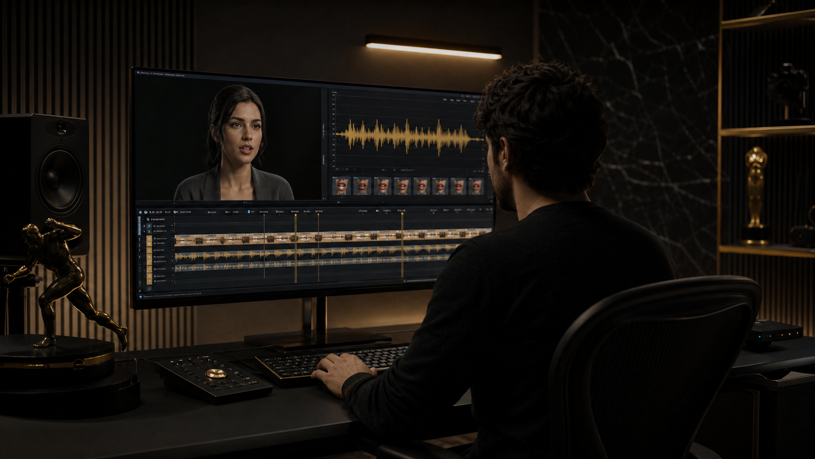
LipSyncX
A Grok motion draft
and a speaking
video
The workflow described in the June 2,
2026 preview guide
lipsync ai
01 / 08
Notes:
Source tutorial: https://lipsyncx.com/blog/grok-imagine-video-1-5-preview-guide
Original title: Grok Imagine Video 1.5 Preview: What Creators Should Know Before Using It
Author: LipSyncX
Source published: 2026-06-02T12:00:00.000Z
Reference links from the tutorial:
https://lipsyncx.com/ai-lip-sync
https://lipsyncx.com/ai-video-dubbing
https://lipsyncx.com/ai-talking-photo-generator
https://lipsyncx.com/models
https://lipsyncx.com
https://docs.x.ai/developers/models/grok-imagine-video-1.5-preview
https://docs.x.ai/developers/pricing
https://docs.x.ai/developers/model-capabilities/video/generation
https://docs.x.ai/developers/model-capabilities/video/image-to-video
https://arena.ai/leaderboard/image-to-video
https://fal.ai/models/xai/grok-imagine-video/v1.5/image-to-video/api
Pricing, provider features and example settings retain the source article's dated context. Consult current provider documentation and the displayed generation quote for a new job.
Cover artwork: https://file.lipsyncx.com/blog-assets/ai-lip-sync-for-youtube/cover.png

Slide 2
The preview’s role
Starting frame
The source guide describes an image-to-video model anchored
by an existing still image.
Motion prompt
Choose one main subject or camera action for the first draft.
Historical context
Model names, rankings and settings in this guide refer to the
June 2026 article.
lipsync ai
02 / 08
Notes:
Source tutorial: https://lipsyncx.com/blog/grok-imagine-video-1-5-preview-guide
Original title: Grok Imagine Video 1.5 Preview: What Creators Should Know Before Using It
Author: LipSyncX
Source published: 2026-06-02T12:00:00.000Z
Reference links from the tutorial:
https://lipsyncx.com/ai-lip-sync
https://lipsyncx.com/ai-video-dubbing
https://lipsyncx.com/ai-talking-photo-generator
https://lipsyncx.com/models
https://lipsyncx.com
https://docs.x.ai/developers/models/grok-imagine-video-1.5-preview
https://docs.x.ai/developers/pricing
https://docs.x.ai/developers/model-capabilities/video/generation
https://docs.x.ai/developers/model-capabilities/video/image-to-video
https://arena.ai/leaderboard/image-to-video
https://fal.ai/models/xai/grok-imagine-video/v1.5/image-to-video/api
Pricing, provider features and example settings retain the source article's dated context. Consult current provider documentation and the displayed generation quote for a new job.

Slide 3
A narrow motion test
Image
Choose a clean portrait, product render or approved storyboard
frame.
Prompt
Describe one visible motion so you can judge whether the model
follows it.
Draft
Use a short test before increasing output quality or producing
variations.
lipsync ai
03 / 08
Notes:
Source tutorial: https://lipsyncx.com/blog/grok-imagine-video-1-5-preview-guide
Original title: Grok Imagine Video 1.5 Preview: What Creators Should Know Before Using It
Author: LipSyncX
Source published: 2026-06-02T12:00:00.000Z
Reference links from the tutorial:
https://lipsyncx.com/ai-lip-sync
https://lipsyncx.com/ai-video-dubbing
https://lipsyncx.com/ai-talking-photo-generator
https://lipsyncx.com/models
https://lipsyncx.com
https://docs.x.ai/developers/models/grok-imagine-video-1.5-preview
https://docs.x.ai/developers/pricing
https://docs.x.ai/developers/model-capabilities/video/generation
https://docs.x.ai/developers/model-capabilities/video/image-to-video
https://arena.ai/leaderboard/image-to-video
https://fal.ai/models/xai/grok-imagine-video/v1.5/image-to-video/api
Pricing, provider features and example settings retain the source article's dated context. Consult current provider documentation and the displayed generation quote for a new job.

Slide 4
The visual acceptance checks
Check | What to inspect
Identity | Face, logo and product shape remain recognizable
Motion | The requested action reads clearly
Mouth | No distracting teeth or lip flicker
Editing | The important action fits inside the clip
Retry cost | Attempts needed to produce one keeper
lipsync ai
04 / 08
Notes:
Source tutorial: https://lipsyncx.com/blog/grok-imagine-video-1-5-preview-guide
Original title: Grok Imagine Video 1.5 Preview: What Creators Should Know Before Using It
Author: LipSyncX
Source published: 2026-06-02T12:00:00.000Z
Reference links from the tutorial:
https://lipsyncx.com/ai-lip-sync
https://lipsyncx.com/ai-video-dubbing
https://lipsyncx.com/ai-talking-photo-generator
https://lipsyncx.com/models
https://lipsyncx.com
https://docs.x.ai/developers/models/grok-imagine-video-1.5-preview
https://docs.x.ai/developers/pricing
https://docs.x.ai/developers/model-capabilities/video/generation
https://docs.x.ai/developers/model-capabilities/video/image-to-video
https://arena.ai/leaderboard/image-to-video
https://fal.ai/models/xai/grok-imagine-video/v1.5/image-to-video/api
Pricing, provider features and example settings retain the source article's dated context. Consult current provider documentation and the displayed generation quote for a new job.

Slide 5
The speech handoff
Talking portrait
Use a dedicated portrait-and-audio route when a face must
deliver a line.
Existing speaker
footage
Use a video lip-sync route for an approved new voice track.
Localization
Approve translated meaning and voice before the final
synchronization pass.
lipsync ai
05 / 08
Notes:
Source tutorial: https://lipsyncx.com/blog/grok-imagine-video-1-5-preview-guide
Original title: Grok Imagine Video 1.5 Preview: What Creators Should Know Before Using It
Author: LipSyncX
Source published: 2026-06-02T12:00:00.000Z
Reference links from the tutorial:
https://lipsyncx.com/ai-lip-sync
https://lipsyncx.com/ai-video-dubbing
https://lipsyncx.com/ai-talking-photo-generator
https://lipsyncx.com/models
https://lipsyncx.com
https://docs.x.ai/developers/models/grok-imagine-video-1.5-preview
https://docs.x.ai/developers/pricing
https://docs.x.ai/developers/model-capabilities/video/generation
https://docs.x.ai/developers/model-capabilities/video/image-to-video
https://arena.ai/leaderboard/image-to-video
https://fal.ai/models/xai/grok-imagine-video/v1.5/image-to-video/api
Pricing, provider features and example settings retain the source article's dated context. Consult current provider documentation and the displayed generation quote for a new job.

Slide 6
The cost calculation
Billable inputs
Check the current provider’s image charge, output seconds and
chosen resolution.
Other costs
Include retries, platform markup, storage and editing effort.
Source date
The original article’s API prices are June 2, 2026 observations,
rather than current purchase quotes.
lipsync ai
06 / 08
Notes:
Source tutorial: https://lipsyncx.com/blog/grok-imagine-video-1-5-preview-guide
Original title: Grok Imagine Video 1.5 Preview: What Creators Should Know Before Using It
Author: LipSyncX
Source published: 2026-06-02T12:00:00.000Z
Reference links from the tutorial:
https://lipsyncx.com/ai-lip-sync
https://lipsyncx.com/ai-video-dubbing
https://lipsyncx.com/ai-talking-photo-generator
https://lipsyncx.com/models
https://lipsyncx.com
https://docs.x.ai/developers/models/grok-imagine-video-1.5-preview
https://docs.x.ai/developers/pricing
https://docs.x.ai/developers/model-capabilities/video/generation
https://docs.x.ai/developers/model-capabilities/video/image-to-video
https://arena.ai/leaderboard/image-to-video
https://fal.ai/models/xai/grok-imagine-video/v1.5/image-to-video/api
Pricing, provider features and example settings retain the source article's dated context. Consult current provider documentation and the displayed generation quote for a new job.

Slide 7
The production decision
Keep the draft
A usable motion result can continue into editing, captions and
speech production.
Change the route
If precise mouth timing is the issue, test a workflow built for
speech alignment.
Expand carefully
Scale only after your own images and prompts pass the
acceptance checks.
lipsync ai
07 / 08
Notes:
Source tutorial: https://lipsyncx.com/blog/grok-imagine-video-1-5-preview-guide
Original title: Grok Imagine Video 1.5 Preview: What Creators Should Know Before Using It
Author: LipSyncX
Source published: 2026-06-02T12:00:00.000Z
Reference links from the tutorial:
https://lipsyncx.com/ai-lip-sync
https://lipsyncx.com/ai-video-dubbing
https://lipsyncx.com/ai-talking-photo-generator
https://lipsyncx.com/models
https://lipsyncx.com
https://docs.x.ai/developers/models/grok-imagine-video-1.5-preview
https://docs.x.ai/developers/pricing
https://docs.x.ai/developers/model-capabilities/video/generation
https://docs.x.ai/developers/model-capabilities/video/image-to-video
https://arena.ai/leaderboard/image-to-video
https://fal.ai/models/xai/grok-imagine-video/v1.5/image-to-video/api
Pricing, provider features and example settings retain the source article's dated context. Consult current provider documentation and the displayed generation quote for a new job.

Slide 8
Your first short test
Use one clear input and one approved recording. Check the quote,
review a short result, then decide what to make next.
lipsync ai
https://lipsyncx.com/
Original blog tutorial
https://lipsyncx.com/blog/grok-imagine-video-1-5-preview-guide
lipsync ai
08 / 08
Notes:
Source tutorial: https://lipsyncx.com/blog/grok-imagine-video-1-5-preview-guide
Original title: Grok Imagine Video 1.5 Preview: What Creators Should Know Before Using It
Author: LipSyncX
Source published: 2026-06-02T12:00:00.000Z
Reference links from the tutorial:
https://lipsyncx.com/ai-lip-sync
https://lipsyncx.com/ai-video-dubbing
https://lipsyncx.com/ai-talking-photo-generator
https://lipsyncx.com/models
https://lipsyncx.com
https://docs.x.ai/developers/models/grok-imagine-video-1.5-preview
https://docs.x.ai/developers/pricing
https://docs.x.ai/developers/model-capabilities/video/generation
https://docs.x.ai/developers/model-capabilities/video/image-to-video
https://arena.ai/leaderboard/image-to-video
https://fal.ai/models/xai/grok-imagine-video/v1.5/image-to-video/api
Pricing, provider features and example settings retain the source article's dated context. Consult current provider documentation and the displayed generation quote for a new job.

