Slide 1
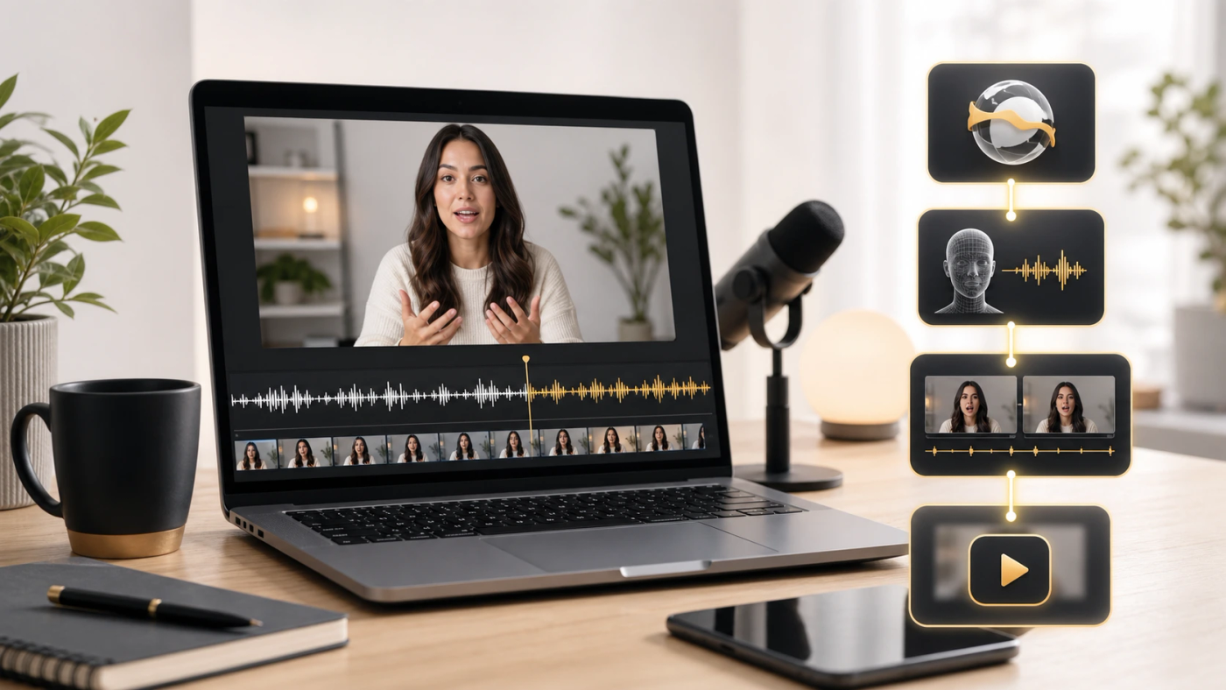
LipSyncX
How to create AI
lip-sync videos
A repeatable workflow from source
footage to final review
lipsync ai
01 / 08
Notes:
Source tutorial: https://lipsyncx.com/blog/how-to-create-ai-lip-sync-videos
Original title: How to Create AI Lip Sync Videos in 2026: A Practical Workflow That Holds Up
Author: LipSyncX Editorial Team
Source published: 2026-05-20T08:02:31.074Z
Reference links from the tutorial:
https://file.lipsyncx.com/blog-assets/how-to-create-ai-lip-sync-videos/body-workflow.webp
https://help.descript.com/hc/en-us/articles/37202655823629-Translate-and-dub-speech-overview
https://support.google.com/youtube/answer/13338784
https://blog.youtube/news-and-events/youtube-auto-dubbing-expressive-speech/
https://help.heygen.com/en/articles/10035614-video-translation-overview
https://lipsyncx.com/studio
https://lipsyncx.com/ai-video-dubbing
https://file.lipsyncx.com/blog-assets/how-to-create-ai-lip-sync-videos/body-comparison.webp
Pricing, provider features and example settings retain the source article's dated context. Consult current provider documentation and the displayed generation quote for a new job.
Cover artwork: https://file.lipsyncx.com/blog-assets/how-to-create-ai-lip-sync-videos/cover.webp

Slide 2
The source footage
Framing
Keep the face large enough to read and the mouth visible.
Stability
Prefer steady lighting and usable camera angles over obstructed
or rapidly changing shots.
Picture lock
Finish the source edit before translation and synchronization.
lipsync ai
02 / 08
Notes:
Source tutorial: https://lipsyncx.com/blog/how-to-create-ai-lip-sync-videos
Original title: How to Create AI Lip Sync Videos in 2026: A Practical Workflow That Holds Up
Author: LipSyncX Editorial Team
Source published: 2026-05-20T08:02:31.074Z
Reference links from the tutorial:
https://file.lipsyncx.com/blog-assets/how-to-create-ai-lip-sync-videos/body-workflow.webp
https://help.descript.com/hc/en-us/articles/37202655823629-Translate-and-dub-speech-overview
https://support.google.com/youtube/answer/13338784
https://blog.youtube/news-and-events/youtube-auto-dubbing-expressive-speech/
https://help.heygen.com/en/articles/10035614-video-translation-overview
https://lipsyncx.com/studio
https://lipsyncx.com/ai-video-dubbing
https://file.lipsyncx.com/blog-assets/how-to-create-ai-lip-sync-videos/body-comparison.webp
Pricing, provider features and example settings retain the source article's dated context. Consult current provider documentation and the displayed generation quote for a new job.

Slide 3
The translated script
Meaning
Preserve the message while rewriting unnatural literal phrasing.
Timing
Keep spoken duration workable for the shot. Add natural
breathing points.
Approval
Check names and pronunciation before making the final voice
track.
lipsync ai
03 / 08
Notes:
Source tutorial: https://lipsyncx.com/blog/how-to-create-ai-lip-sync-videos
Original title: How to Create AI Lip Sync Videos in 2026: A Practical Workflow That Holds Up
Author: LipSyncX Editorial Team
Source published: 2026-05-20T08:02:31.074Z
Reference links from the tutorial:
https://file.lipsyncx.com/blog-assets/how-to-create-ai-lip-sync-videos/body-workflow.webp
https://help.descript.com/hc/en-us/articles/37202655823629-Translate-and-dub-speech-overview
https://support.google.com/youtube/answer/13338784
https://blog.youtube/news-and-events/youtube-auto-dubbing-expressive-speech/
https://help.heygen.com/en/articles/10035614-video-translation-overview
https://lipsyncx.com/studio
https://lipsyncx.com/ai-video-dubbing
https://file.lipsyncx.com/blog-assets/how-to-create-ai-lip-sync-videos/body-comparison.webp
Pricing, provider features and example settings retain the source article's dated context. Consult current provider documentation and the displayed generation quote for a new job.

Slide 4
The right output path
Video need | Output to test
Text accessibility | Translated subtitles
Audio-led content | Dubbed speech
A prominent visible speaker | Dubbed speech with visual lip sync
lipsync ai
04 / 08
Notes:
Source tutorial: https://lipsyncx.com/blog/how-to-create-ai-lip-sync-videos
Original title: How to Create AI Lip Sync Videos in 2026: A Practical Workflow That Holds Up
Author: LipSyncX Editorial Team
Source published: 2026-05-20T08:02:31.074Z
Reference links from the tutorial:
https://file.lipsyncx.com/blog-assets/how-to-create-ai-lip-sync-videos/body-workflow.webp
https://help.descript.com/hc/en-us/articles/37202655823629-Translate-and-dub-speech-overview
https://support.google.com/youtube/answer/13338784
https://blog.youtube/news-and-events/youtube-auto-dubbing-expressive-speech/
https://help.heygen.com/en/articles/10035614-video-translation-overview
https://lipsyncx.com/studio
https://lipsyncx.com/ai-video-dubbing
https://file.lipsyncx.com/blog-assets/how-to-create-ai-lip-sync-videos/body-comparison.webp
Pricing, provider features and example settings retain the source article's dated context. Consult current provider documentation and the displayed generation quote for a new job.

Slide 5
The short preview
Quote
Check the model, resolution, duration and estimated credits.
Sample
Generate one representative section using the approved voice.
Decision
Choose a script correction, a source change or another render
based on the actual issue.
lipsync ai
05 / 08
Notes:
Source tutorial: https://lipsyncx.com/blog/how-to-create-ai-lip-sync-videos
Original title: How to Create AI Lip Sync Videos in 2026: A Practical Workflow That Holds Up
Author: LipSyncX Editorial Team
Source published: 2026-05-20T08:02:31.074Z
Reference links from the tutorial:
https://file.lipsyncx.com/blog-assets/how-to-create-ai-lip-sync-videos/body-workflow.webp
https://help.descript.com/hc/en-us/articles/37202655823629-Translate-and-dub-speech-overview
https://support.google.com/youtube/answer/13338784
https://blog.youtube/news-and-events/youtube-auto-dubbing-expressive-speech/
https://help.heygen.com/en/articles/10035614-video-translation-overview
https://lipsyncx.com/studio
https://lipsyncx.com/ai-video-dubbing
https://file.lipsyncx.com/blog-assets/how-to-create-ai-lip-sync-videos/body-comparison.webp
Pricing, provider features and example settings retain the source article's dated context. Consult current provider documentation and the displayed generation quote for a new job.

Slide 6
The editorial review
Speech
Listen for rushed phrasing and clipped sentence endings.
Synchronization
Watch stressed sounds, pauses and mouth closures.
Expression
Check that the visible face suits the intent and tone of the line.
lipsync ai
06 / 08
Notes:
Source tutorial: https://lipsyncx.com/blog/how-to-create-ai-lip-sync-videos
Original title: How to Create AI Lip Sync Videos in 2026: A Practical Workflow That Holds Up
Author: LipSyncX Editorial Team
Source published: 2026-05-20T08:02:31.074Z
Reference links from the tutorial:
https://file.lipsyncx.com/blog-assets/how-to-create-ai-lip-sync-videos/body-workflow.webp
https://help.descript.com/hc/en-us/articles/37202655823629-Translate-and-dub-speech-overview
https://support.google.com/youtube/answer/13338784
https://blog.youtube/news-and-events/youtube-auto-dubbing-expressive-speech/
https://help.heygen.com/en/articles/10035614-video-translation-overview
https://lipsyncx.com/studio
https://lipsyncx.com/ai-video-dubbing
https://file.lipsyncx.com/blog-assets/how-to-create-ai-lip-sync-videos/body-comparison.webp
Pricing, provider features and example settings retain the source article's dated context. Consult current provider documentation and the displayed generation quote for a new job.

Slide 7
The publishable version
Versions
Keep the approved source, translated script and audio together.
Export
Use a clear filename and review the finished file, including
captions.
Repeatability
Record what changed and preserve a usable path from preview
to final output.
lipsync ai
07 / 08
Notes:
Source tutorial: https://lipsyncx.com/blog/how-to-create-ai-lip-sync-videos
Original title: How to Create AI Lip Sync Videos in 2026: A Practical Workflow That Holds Up
Author: LipSyncX Editorial Team
Source published: 2026-05-20T08:02:31.074Z
Reference links from the tutorial:
https://file.lipsyncx.com/blog-assets/how-to-create-ai-lip-sync-videos/body-workflow.webp
https://help.descript.com/hc/en-us/articles/37202655823629-Translate-and-dub-speech-overview
https://support.google.com/youtube/answer/13338784
https://blog.youtube/news-and-events/youtube-auto-dubbing-expressive-speech/
https://help.heygen.com/en/articles/10035614-video-translation-overview
https://lipsyncx.com/studio
https://lipsyncx.com/ai-video-dubbing
https://file.lipsyncx.com/blog-assets/how-to-create-ai-lip-sync-videos/body-comparison.webp
Pricing, provider features and example settings retain the source article's dated context. Consult current provider documentation and the displayed generation quote for a new job.

Slide 8
Your first short test
Use one clear input and one approved recording. Check the quote,
review a short result, then decide what to make next.
lipsync ai
https://lipsyncx.com/
Original blog tutorial
https://lipsyncx.com/blog/how-to-create-ai-lip-sync-videos
lipsync ai
08 / 08
Notes:
Source tutorial: https://lipsyncx.com/blog/how-to-create-ai-lip-sync-videos
Original title: How to Create AI Lip Sync Videos in 2026: A Practical Workflow That Holds Up
Author: LipSyncX Editorial Team
Source published: 2026-05-20T08:02:31.074Z
Reference links from the tutorial:
https://file.lipsyncx.com/blog-assets/how-to-create-ai-lip-sync-videos/body-workflow.webp
https://help.descript.com/hc/en-us/articles/37202655823629-Translate-and-dub-speech-overview
https://support.google.com/youtube/answer/13338784
https://blog.youtube/news-and-events/youtube-auto-dubbing-expressive-speech/
https://help.heygen.com/en/articles/10035614-video-translation-overview
https://lipsyncx.com/studio
https://lipsyncx.com/ai-video-dubbing
https://file.lipsyncx.com/blog-assets/how-to-create-ai-lip-sync-videos/body-comparison.webp
Pricing, provider features and example settings retain the source article's dated context. Consult current provider documentation and the displayed generation quote for a new job.

