Slide 1
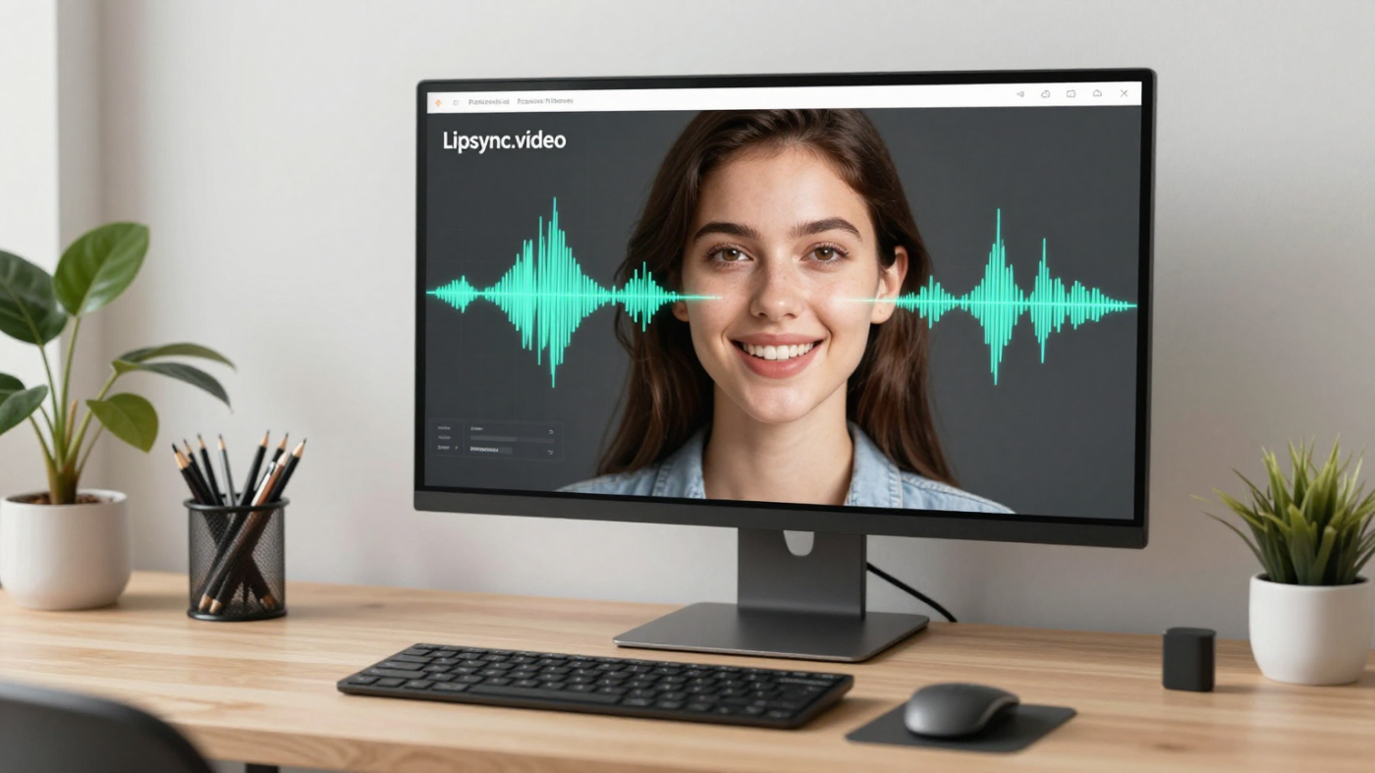
LipSyncX
A creator’s guide to
lip-sync video AI
Better inputs, natural speech and a
consistent review process
lipsync ai
01 / 08
Notes:
Source tutorial: https://lipsyncx.com/blog/lipsync-video-ai-2026-guide
Original title: Lipsync.video AI in 2026: Practical Guide for Creators
Author: LipSyncX
Source published: 2026-05-06T06:52:29.246Z
Reference links from the tutorial:
https://file.celebrityai.club/blog-images/f58048f1-2f65-4cfd-a4d9-4c0667f6a4a4.webp
https://file.celebrityai.club/blog-images/88e9221c-56e3-424a-9edc-cec94e94f0f1.webp
https://file.celebrityai.club/blog-images/30ba8c83-53dd-4c94-8025-5a65c5515863.webp
https://file.celebrityai.club/blog-images/7d7c806d-b06f-41f7-a6c7-028421f93e1d.webp
https://file.celebrityai.club/blog-images/0a2e330c-8708-4de6-94e5-a88b6242cb3f.webp
https://lipsync.video/
https://lipsync.video/pricing
https://lipsyncx.com
https://www.heygen.com/pricing
https://www.kapwing.com/pricing?refresh=true
https://www.robots.ox.ac.uk/~vgg/software/lipsync/
https://arxiv.org/abs/2008.10010
Pricing, provider features and example settings retain the source article's dated context. Consult current provider documentation and the displayed generation quote for a new job.
Cover artwork: https://file.celebrityai.club/blog-images/f58048f1-2f65-4cfd-a4d9-4c0667f6a4a4.webp

Slide 2
The speech-alignment process
Audio
Speech timing provides information about the sounds and
pauses.
Face
The model generates visible mouth motion from a portrait or
speaker video.
Output
A completed render still needs a visual and audio review.
lipsync ai
02 / 08
Notes:
Source tutorial: https://lipsyncx.com/blog/lipsync-video-ai-2026-guide
Original title: Lipsync.video AI in 2026: Practical Guide for Creators
Author: LipSyncX
Source published: 2026-05-06T06:52:29.246Z
Reference links from the tutorial:
https://file.celebrityai.club/blog-images/f58048f1-2f65-4cfd-a4d9-4c0667f6a4a4.webp
https://file.celebrityai.club/blog-images/88e9221c-56e3-424a-9edc-cec94e94f0f1.webp
https://file.celebrityai.club/blog-images/30ba8c83-53dd-4c94-8025-5a65c5515863.webp
https://file.celebrityai.club/blog-images/7d7c806d-b06f-41f7-a6c7-028421f93e1d.webp
https://file.celebrityai.club/blog-images/0a2e330c-8708-4de6-94e5-a88b6242cb3f.webp
https://lipsync.video/
https://lipsync.video/pricing
https://lipsyncx.com
https://www.heygen.com/pricing
https://www.kapwing.com/pricing?refresh=true
https://www.robots.ox.ac.uk/~vgg/software/lipsync/
https://arxiv.org/abs/2008.10010
Pricing, provider features and example settings retain the source article's dated context. Consult current provider documentation and the displayed generation quote for a new job.

Slide 3
The strongest production uses
Localization
A visible speaker can deliver a reviewed version for another
language audience.
Product and
training
Short presenter segments can introduce demos, onboarding or
lessons.
Creative testing
Reuse suitable source material to test approved hooks or voice
tracks.
lipsync ai
03 / 08
Notes:
Source tutorial: https://lipsyncx.com/blog/lipsync-video-ai-2026-guide
Original title: Lipsync.video AI in 2026: Practical Guide for Creators
Author: LipSyncX
Source published: 2026-05-06T06:52:29.246Z
Reference links from the tutorial:
https://file.celebrityai.club/blog-images/f58048f1-2f65-4cfd-a4d9-4c0667f6a4a4.webp
https://file.celebrityai.club/blog-images/88e9221c-56e3-424a-9edc-cec94e94f0f1.webp
https://file.celebrityai.club/blog-images/30ba8c83-53dd-4c94-8025-5a65c5515863.webp
https://file.celebrityai.club/blog-images/7d7c806d-b06f-41f7-a6c7-028421f93e1d.webp
https://file.celebrityai.club/blog-images/0a2e330c-8708-4de6-94e5-a88b6242cb3f.webp
https://lipsync.video/
https://lipsync.video/pricing
https://lipsyncx.com
https://www.heygen.com/pricing
https://www.kapwing.com/pricing?refresh=true
https://www.robots.ox.ac.uk/~vgg/software/lipsync/
https://arxiv.org/abs/2008.10010
Pricing, provider features and example settings retain the source article's dated context. Consult current provider documentation and the displayed generation quote for a new job.

Slide 4
The input checklist
Picture
Use a visible mouth, usable facial detail and stable framing.
Voice
Upload clean speech with natural pacing and no unintended
overlapping speakers.
Emotion
Match the delivery and script to the person’s visible expression.
lipsync ai
04 / 08
Notes:
Source tutorial: https://lipsyncx.com/blog/lipsync-video-ai-2026-guide
Original title: Lipsync.video AI in 2026: Practical Guide for Creators
Author: LipSyncX
Source published: 2026-05-06T06:52:29.246Z
Reference links from the tutorial:
https://file.celebrityai.club/blog-images/f58048f1-2f65-4cfd-a4d9-4c0667f6a4a4.webp
https://file.celebrityai.club/blog-images/88e9221c-56e3-424a-9edc-cec94e94f0f1.webp
https://file.celebrityai.club/blog-images/30ba8c83-53dd-4c94-8025-5a65c5515863.webp
https://file.celebrityai.club/blog-images/7d7c806d-b06f-41f7-a6c7-028421f93e1d.webp
https://file.celebrityai.club/blog-images/0a2e330c-8708-4de6-94e5-a88b6242cb3f.webp
https://lipsync.video/
https://lipsync.video/pricing
https://lipsyncx.com
https://www.heygen.com/pricing
https://www.kapwing.com/pricing?refresh=true
https://www.robots.ox.ac.uk/~vgg/software/lipsync/
https://arxiv.org/abs/2008.10010
Pricing, provider features and example settings retain the source article's dated context. Consult current provider documentation and the displayed generation quote for a new job.

Slide 5
The high-attention moments
Opening
Inspect the first sentence at the final display size.
Specific facts
Check product names, numbers, prices and dates.
Closing
Review the final action line and any mouth close-ups.
lipsync ai
05 / 08
Notes:
Source tutorial: https://lipsyncx.com/blog/lipsync-video-ai-2026-guide
Original title: Lipsync.video AI in 2026: Practical Guide for Creators
Author: LipSyncX
Source published: 2026-05-06T06:52:29.246Z
Reference links from the tutorial:
https://file.celebrityai.club/blog-images/f58048f1-2f65-4cfd-a4d9-4c0667f6a4a4.webp
https://file.celebrityai.club/blog-images/88e9221c-56e3-424a-9edc-cec94e94f0f1.webp
https://file.celebrityai.club/blog-images/30ba8c83-53dd-4c94-8025-5a65c5515863.webp
https://file.celebrityai.club/blog-images/7d7c806d-b06f-41f7-a6c7-028421f93e1d.webp
https://file.celebrityai.club/blog-images/0a2e330c-8708-4de6-94e5-a88b6242cb3f.webp
https://lipsync.video/
https://lipsync.video/pricing
https://lipsyncx.com
https://www.heygen.com/pricing
https://www.kapwing.com/pricing?refresh=true
https://www.robots.ox.ac.uk/~vgg/software/lipsync/
https://arxiv.org/abs/2008.10010
Pricing, provider features and example settings retain the source article's dated context. Consult current provider documentation and the displayed generation quote for a new job.

Slide 6
The matched tool pilot
Same input
Use one short speaker clip and the same audio across the
shortlist.
Same output
Match duration and resolution as closely as possible.
Total cost
Include retries and review effort. Confirm current billing and
export conditions.
lipsync ai
06 / 08
Notes:
Source tutorial: https://lipsyncx.com/blog/lipsync-video-ai-2026-guide
Original title: Lipsync.video AI in 2026: Practical Guide for Creators
Author: LipSyncX
Source published: 2026-05-06T06:52:29.246Z
Reference links from the tutorial:
https://file.celebrityai.club/blog-images/f58048f1-2f65-4cfd-a4d9-4c0667f6a4a4.webp
https://file.celebrityai.club/blog-images/88e9221c-56e3-424a-9edc-cec94e94f0f1.webp
https://file.celebrityai.club/blog-images/30ba8c83-53dd-4c94-8025-5a65c5515863.webp
https://file.celebrityai.club/blog-images/7d7c806d-b06f-41f7-a6c7-028421f93e1d.webp
https://file.celebrityai.club/blog-images/0a2e330c-8708-4de6-94e5-a88b6242cb3f.webp
https://lipsync.video/
https://lipsync.video/pricing
https://lipsyncx.com
https://www.heygen.com/pricing
https://www.kapwing.com/pricing?refresh=true
https://www.robots.ox.ac.uk/~vgg/software/lipsync/
https://arxiv.org/abs/2008.10010
Pricing, provider features and example settings retain the source article's dated context. Consult current provider documentation and the displayed generation quote for a new job.

Slide 7
The approval record
Inputs
Keep permissions for the source footage, portrait and voice.
Script
Approve the spoken and translated claims before generation.
Final export
Archive the accepted result and disclose generated or altered
media where appropriate.
lipsync ai
07 / 08
Notes:
Source tutorial: https://lipsyncx.com/blog/lipsync-video-ai-2026-guide
Original title: Lipsync.video AI in 2026: Practical Guide for Creators
Author: LipSyncX
Source published: 2026-05-06T06:52:29.246Z
Reference links from the tutorial:
https://file.celebrityai.club/blog-images/f58048f1-2f65-4cfd-a4d9-4c0667f6a4a4.webp
https://file.celebrityai.club/blog-images/88e9221c-56e3-424a-9edc-cec94e94f0f1.webp
https://file.celebrityai.club/blog-images/30ba8c83-53dd-4c94-8025-5a65c5515863.webp
https://file.celebrityai.club/blog-images/7d7c806d-b06f-41f7-a6c7-028421f93e1d.webp
https://file.celebrityai.club/blog-images/0a2e330c-8708-4de6-94e5-a88b6242cb3f.webp
https://lipsync.video/
https://lipsync.video/pricing
https://lipsyncx.com
https://www.heygen.com/pricing
https://www.kapwing.com/pricing?refresh=true
https://www.robots.ox.ac.uk/~vgg/software/lipsync/
https://arxiv.org/abs/2008.10010
Pricing, provider features and example settings retain the source article's dated context. Consult current provider documentation and the displayed generation quote for a new job.

Slide 8
Your first short test
Use one clear input and one approved recording. Check the quote,
review a short result, then decide what to make next.
lipsync ai
https://lipsyncx.com/
Original blog tutorial
https://lipsyncx.com/blog/lipsync-video-ai-2026-guide
lipsync ai
08 / 08
Notes:
Source tutorial: https://lipsyncx.com/blog/lipsync-video-ai-2026-guide
Original title: Lipsync.video AI in 2026: Practical Guide for Creators
Author: LipSyncX
Source published: 2026-05-06T06:52:29.246Z
Reference links from the tutorial:
https://file.celebrityai.club/blog-images/f58048f1-2f65-4cfd-a4d9-4c0667f6a4a4.webp
https://file.celebrityai.club/blog-images/88e9221c-56e3-424a-9edc-cec94e94f0f1.webp
https://file.celebrityai.club/blog-images/30ba8c83-53dd-4c94-8025-5a65c5515863.webp
https://file.celebrityai.club/blog-images/7d7c806d-b06f-41f7-a6c7-028421f93e1d.webp
https://file.celebrityai.club/blog-images/0a2e330c-8708-4de6-94e5-a88b6242cb3f.webp
https://lipsync.video/
https://lipsync.video/pricing
https://lipsyncx.com
https://www.heygen.com/pricing
https://www.kapwing.com/pricing?refresh=true
https://www.robots.ox.ac.uk/~vgg/software/lipsync/
https://arxiv.org/abs/2008.10010
Pricing, provider features and example settings retain the source article's dated context. Consult current provider documentation and the displayed generation quote for a new job.

