Slide 1
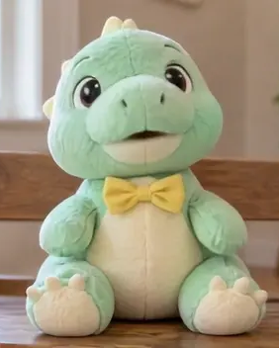
LipSyncX
A party greeting
from a childhood
toy
Your familiar character, a finished
recording and a short test
lipsync ai
01 / 08
Notes:
Source tutorial: https://lipsyncx.com/blog/make-childhood-toy-talk-for-party
Original title: Make Your Childhood Toy Give a Party Speech With Your Own Audio
Author: LipSyncX Team
Source published: 2026-10-23T09:30:24.347Z
Reference links from the tutorial:
Pricing, provider features and example settings retain the source article's dated context. Consult current provider documentation and the displayed generation quote for a new job.
Cover artwork: /blog-assets/scenario-guides-2026-10/plush-poster.webp

Slide 2
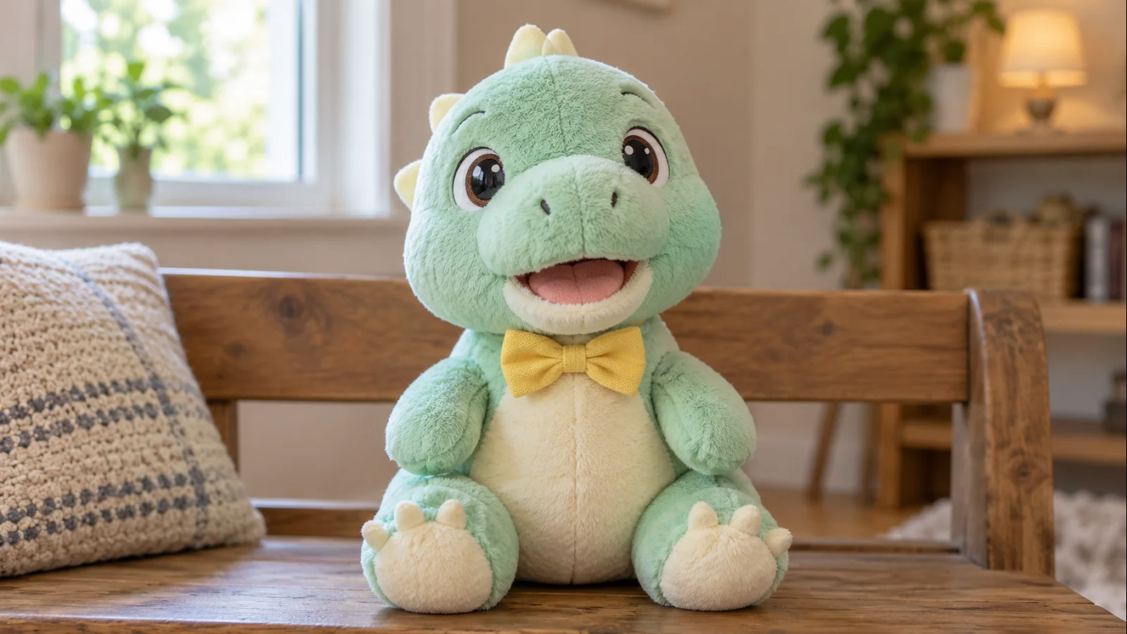
The toy photograph
Composition
Photograph the toy at eye level with one clear face
and even light.
Mouth
Keep the muzzle unobstructed and large enough to
inspect.
Test first
A stitched smile or unusual snout may animate
differently from the guide’s dinosaur.
lipsync ai
02 / 08
Notes:
Source tutorial: https://lipsyncx.com/blog/make-childhood-toy-talk-for-party
Original title: Make Your Childhood Toy Give a Party Speech With Your Own Audio
Author: LipSyncX Team
Source published: 2026-10-23T09:30:24.347Z
Reference links from the tutorial:
Pricing, provider features and example settings retain the source article's dated context. Consult current provider documentation and the displayed generation quote for a new job.
Image source: https://lipsyncx.com/blog-assets/scenario-guides-2026-10/plush-input.webp
Images and product screenshots retain the original article's example context. Shared screenshots illustrate controls, rather than the specific example's render history.

Slide 3
The personal message
Shared memory
Choose a real memory the family is comfortable sharing.
Occasion
Write the message from the toy’s point of view.
Warm ending
Keep the greeting short and leave space for the rest of the
celebration film.
lipsync ai
03 / 08
Notes:
Source tutorial: https://lipsyncx.com/blog/make-childhood-toy-talk-for-party
Original title: Make Your Childhood Toy Give a Party Speech With Your Own Audio
Author: LipSyncX Team
Source published: 2026-10-23T09:30:24.347Z
Reference links from the tutorial:
Pricing, provider features and example settings retain the source article's dated context. Consult current provider documentation and the displayed generation quote for a new job.

Slide 4
The recording and upload
Voice
Record in a quiet room or export a finished voiceover. Add party
music later.
Audio mode
Upload the toy image and the recording you want to keep.
Replay
Check the first word, ending and unwanted silence before
generation.
lipsync ai
04 / 08
Notes:
Source tutorial: https://lipsyncx.com/blog/make-childhood-toy-talk-for-party
Original title: Make Your Childhood Toy Give a Party Speech With Your Own Audio
Author: LipSyncX Team
Source published: 2026-10-23T09:30:24.347Z
Reference links from the tutorial:
Pricing, provider features and example settings retain the source article's dated context. Consult current provider documentation and the displayed generation quote for a new job.

Slide 5
The first short render
Sample
Start with one 5–10 second sentence using the actual toy photo.
Quote
Read the selected model, resolution and estimated credits.
Corrections
A new audio version can need another generation. Budget for
review.
lipsync ai
05 / 08
Notes:
Source tutorial: https://lipsyncx.com/blog/make-childhood-toy-talk-for-party
Original title: Make Your Childhood Toy Give a Party Speech With Your Own Audio
Author: LipSyncX Team
Source published: 2026-10-23T09:30:24.347Z
Reference links from the tutorial:
Pricing, provider features and example settings retain the source article's dated context. Consult current provider documentation and the displayed generation quote for a new job.

Slide 6
The toy’s facial review
With sound
Check that movement follows the words and the last word stays
complete.
Muted
Watch for fabric or muzzle distortion and distracting movement.
Next attempt
Change one input at a time, such as a clearer photo or a shorter
line.
lipsync ai
06 / 08
Notes:
Source tutorial: https://lipsyncx.com/blog/make-childhood-toy-talk-for-party
Original title: Make Your Childhood Toy Give a Party Speech With Your Own Audio
Author: LipSyncX Team
Source published: 2026-10-23T09:30:24.347Z
Reference links from the tutorial:
Pricing, provider features and example settings retain the source article's dated context. Consult current provider documentation and the displayed generation quote for a new job.

Slide 7
The celebration-film edit
Assembly
Import the MP4 before the photo montage and lower music
under the voice.
Titles
Add family photos, transitions and text in your usual editor.
Venue check
Test the local exported file on the actual playback equipment.
lipsync ai
07 / 08
Notes:
Source tutorial: https://lipsyncx.com/blog/make-childhood-toy-talk-for-party
Original title: Make Your Childhood Toy Give a Party Speech With Your Own Audio
Author: LipSyncX Team
Source published: 2026-10-23T09:30:24.347Z
Reference links from the tutorial:
Pricing, provider features and example settings retain the source article's dated context. Consult current provider documentation and the displayed generation quote for a new job.

Slide 8
Your first short test
Use one clear input and one approved recording. Check the quote,
review a short result, then decide what to make next.
lipsync ai
https://lipsyncx.com/
Original blog tutorial
https://lipsyncx.com/blog/make-childhood-toy-talk-for-party
lipsync ai
08 / 08
Notes:
Source tutorial: https://lipsyncx.com/blog/make-childhood-toy-talk-for-party
Original title: Make Your Childhood Toy Give a Party Speech With Your Own Audio
Author: LipSyncX Team
Source published: 2026-10-23T09:30:24.347Z
Reference links from the tutorial:
Pricing, provider features and example settings retain the source article's dated context. Consult current provider documentation and the displayed generation quote for a new job.

