Slide 1

LipSyncX
How to make a
company mascot
talk
One welcome message before an
employee-onboarding series
lipsync ai
01 / 08
Notes:
Source tutorial: https://lipsyncx.com/blog/make-company-mascot-talk
Original title: How to Make a Company Mascot Talk With Your Own Audio
Author: LipSyncX Team
Source published: 2026-10-22T13:35:27.502Z
Reference links from the tutorial:
Pricing, provider features and example settings retain the source article's dated context. Consult current provider documentation and the displayed generation quote for a new job.
Cover artwork: /blog-assets/make-company-mascot-talk/cover.webp

Slide 2

The approved mascot
Artwork
Use a character you own or have permission to
animate.
Framing
Start with one front-facing face, a visible mouth and a
simple background.
First line
A short reusable welcome gives the first render a clear
purpose.
lipsync ai
02 / 08
Notes:
Source tutorial: https://lipsyncx.com/blog/make-company-mascot-talk
Original title: How to Make a Company Mascot Talk With Your Own Audio
Author: LipSyncX Team
Source published: 2026-10-22T13:35:27.502Z
Reference links from the tutorial:
Pricing, provider features and example settings retain the source article's dated context. Consult current provider documentation and the displayed generation quote for a new job.
Image source: https://lipsyncx.com/blog-assets/make-company-mascot-talk/fox-input.webp
Images and product screenshots retain the original article's example context. Shared screenshots illustrate controls, rather than the specific example's render history.

Slide 3
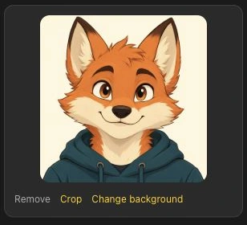
The character input
Upload
Open the character tool and load the approved image.
Preview
Confirm the intended character and version before
adding audio.
Composition
Keep an approved crop and background when they
already fit the message.
lipsync ai
03 / 08
Notes:
Source tutorial: https://lipsyncx.com/blog/make-company-mascot-talk
Original title: How to Make a Company Mascot Talk With Your Own Audio
Author: LipSyncX Team
Source published: 2026-10-22T13:35:27.502Z
Reference links from the tutorial:
Pricing, provider features and example settings retain the source article's dated context. Consult current provider documentation and the displayed generation quote for a new job.
Image source: https://lipsyncx.com/blog-assets/make-company-mascot-talk/step-1-character.webp
Images and product screenshots retain the original article's example context. Shared screenshots illustrate controls, rather than the specific example's render history.

Slide 4
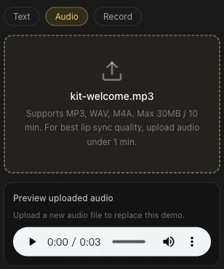
The recurring voice
Audio mode
Upload the finished recording in the mascot’s chosen
voice.
Short test
Begin with about 5–10 seconds of clear speech.
Replay
Check pronunciation, pauses and the first and last
words.
lipsync ai
04 / 08
Notes:
Source tutorial: https://lipsyncx.com/blog/make-company-mascot-talk
Original title: How to Make a Company Mascot Talk With Your Own Audio
Author: LipSyncX Team
Source published: 2026-10-22T13:35:27.502Z
Reference links from the tutorial:
Pricing, provider features and example settings retain the source article's dated context. Consult current provider documentation and the displayed generation quote for a new job.
Image source: https://lipsyncx.com/blog-assets/make-company-mascot-talk/step-2-audio.webp
Images and product screenshots retain the original article's example context. Shared screenshots illustrate controls, rather than the specific example's render history.

Slide 5
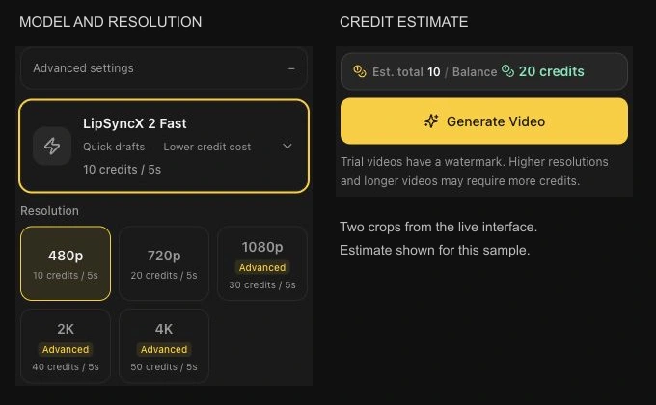
The model and quote
Advanced settings
Read the active model and resolution.
Estimate
Compare the actual file’s credit quote with the
available balance.
Source date
Screenshots document the October 22, 2026
interface. Check current controls for your job.
lipsync ai
05 / 08
Notes:
Source tutorial: https://lipsyncx.com/blog/make-company-mascot-talk
Original title: How to Make a Company Mascot Talk With Your Own Audio
Author: LipSyncX Team
Source published: 2026-10-22T13:35:27.502Z
Reference links from the tutorial:
Pricing, provider features and example settings retain the source article's dated context. Consult current provider documentation and the displayed generation quote for a new job.
Image source: https://lipsyncx.com/blog-assets/make-company-mascot-talk/step-3-settings.webp
Images and product screenshots retain the original article's example context. Shared screenshots illustrate controls, rather than the specific example's render history.

Slide 6
The finished character check
Speech
Inspect mouth timing, sentence endings and behavior during
silence.
Appearance
Look for changes to teeth, outfit, face outline and background.
Correction
Keep original inputs and change one setting at a time when
comparing attempts.
lipsync ai
06 / 08
Notes:
Source tutorial: https://lipsyncx.com/blog/make-company-mascot-talk
Original title: How to Make a Company Mascot Talk With Your Own Audio
Author: LipSyncX Team
Source published: 2026-10-22T13:35:27.502Z
Reference links from the tutorial:
Pricing, provider features and example settings retain the source article's dated context. Consult current provider documentation and the displayed generation quote for a new job.

Slide 7
The first onboarding modules
Module | Job | Suggested starting length
Welcome | Introduce the guide and where to begin | 10–20 seconds
Meet HR | Explain a department and help route | 20–45 seconds
One company value | Show a specific expected behavior | 20–45 seconds
These are editorial starting lengths. Add captions and course material in your editor or learning platform.
lipsync ai
07 / 08
Notes:
Source tutorial: https://lipsyncx.com/blog/make-company-mascot-talk
Original title: How to Make a Company Mascot Talk With Your Own Audio
Author: LipSyncX Team
Source published: 2026-10-22T13:35:27.502Z
Reference links from the tutorial:
Pricing, provider features and example settings retain the source article's dated context. Consult current provider documentation and the displayed generation quote for a new job.

Slide 8
Your first short test
Use one clear input and one approved recording. Check the quote,
review a short result, then decide what to make next.
lipsync ai
https://lipsyncx.com/
Original blog tutorial
https://lipsyncx.com/blog/make-company-mascot-talk
lipsync ai
08 / 08
Notes:
Source tutorial: https://lipsyncx.com/blog/make-company-mascot-talk
Original title: How to Make a Company Mascot Talk With Your Own Audio
Author: LipSyncX Team
Source published: 2026-10-22T13:35:27.502Z
Reference links from the tutorial:
Pricing, provider features and example settings retain the source article's dated context. Consult current provider documentation and the displayed generation quote for a new job.

