Slide 1
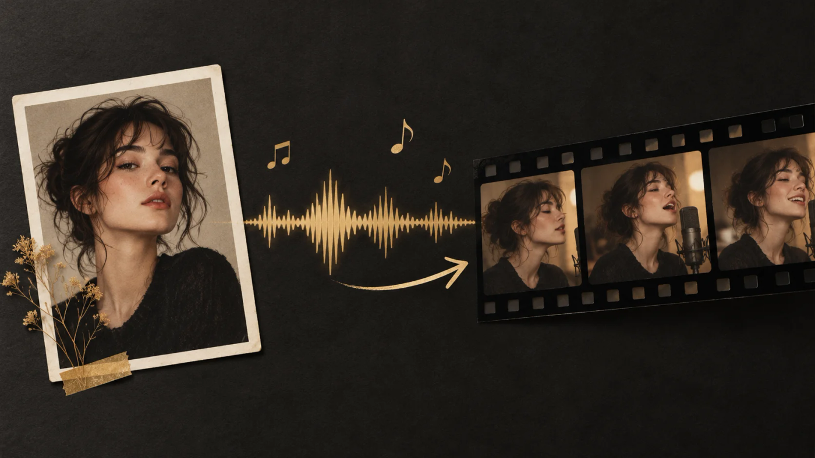
LipSyncX
A singing photo
from your Suno
song
An audio-file handoff from a finished song
to a portrait
lipsync ai
01 / 08
Notes:
Source tutorial: https://lipsyncx.com/blog/make-photo-sing-suno-song-own-audio
Original title: How to Make a Photo Sing a Suno Song With Your Own Audio
Author: LipSyncX Team
Source published: 2026-10-12T07:38:55.531Z
Reference links from the tutorial:
https://help.suno.com/en/articles/13926081
https://help.suno.com/en/articles/13614785
https://help.suno.com/en/articles/9601665
Pricing, provider features and example settings retain the source article's dated context. Consult current provider documentation and the displayed generation quote for a new job.
Cover artwork: /blog-assets/make-photo-sing-suno-song-own-audio/cover.webp

Slide 2
The song export
Download
Export the song audio from your Suno account. A share link is
different from a local audio file.
Format
Check the formats and download allowance available to your
account.
Permissions
Confirm the song’s usage rights and permission to animate the
portrait.
lipsync ai
02 / 08
Notes:
Source tutorial: https://lipsyncx.com/blog/make-photo-sing-suno-song-own-audio
Original title: How to Make a Photo Sing a Suno Song With Your Own Audio
Author: LipSyncX Team
Source published: 2026-10-12T07:38:55.531Z
Reference links from the tutorial:
https://help.suno.com/en/articles/13926081
https://help.suno.com/en/articles/13614785
https://help.suno.com/en/articles/9601665
Pricing, provider features and example settings retain the source article's dated context. Consult current provider documentation and the displayed generation quote for a new job.

Slide 3
A useful first vocal passage
Moment | What it tests
Clear chorus | Mouth movement follows audible lyrics
Held note | Face stability during a longer vowel
Brief pause | Behavior when the vocal stops
Fast phrase | Timing as the lyrics speed up
lipsync ai
03 / 08
Notes:
Source tutorial: https://lipsyncx.com/blog/make-photo-sing-suno-song-own-audio
Original title: How to Make a Photo Sing a Suno Song With Your Own Audio
Author: LipSyncX Team
Source published: 2026-10-12T07:38:55.531Z
Reference links from the tutorial:
https://help.suno.com/en/articles/13926081
https://help.suno.com/en/articles/13614785
https://help.suno.com/en/articles/9601665
Pricing, provider features and example settings retain the source article's dated context. Consult current provider documentation and the displayed generation quote for a new job.

Slide 4
The first 10–15 seconds
Vocal clarity
Choose one lead vocal rather than a long instrumental opening.
Trim
Keep the first word and final syllable intact.
Reference
Preserve the exact source section so later attempts remain
comparable.
lipsync ai
04 / 08
Notes:
Source tutorial: https://lipsyncx.com/blog/make-photo-sing-suno-song-own-audio
Original title: How to Make a Photo Sing a Suno Song With Your Own Audio
Author: LipSyncX Team
Source published: 2026-10-12T07:38:55.531Z
Reference links from the tutorial:
https://help.suno.com/en/articles/13926081
https://help.suno.com/en/articles/13614785
https://help.suno.com/en/articles/9601665
Pricing, provider features and example settings retain the source article's dated context. Consult current provider documentation and the displayed generation quote for a new job.

Slide 5
The portrait and Audio upload
Portrait
Open Make Photo Sing and upload a clear image with a visible
mouth.
Recording
Choose Audio, replace the demo file and replay your song
excerpt.
Quote
Check the active model, resolution and duration limits before
rendering.
lipsync ai
05 / 08
Notes:
Source tutorial: https://lipsyncx.com/blog/make-photo-sing-suno-song-own-audio
Original title: How to Make a Photo Sing a Suno Song With Your Own Audio
Author: LipSyncX Team
Source published: 2026-10-12T07:38:55.531Z
Reference links from the tutorial:
https://help.suno.com/en/articles/13926081
https://help.suno.com/en/articles/13614785
https://help.suno.com/en/articles/9601665
Pricing, provider features and example settings retain the source article's dated context. Consult current provider documentation and the displayed generation quote for a new job.

Slide 6
The vocal-stem comparison
Starting point
Try the existing mix when the lead vocal is clear enough.
Diagnostic option
A vocal-only stem can help test whether dense instruments are
confusing the result.
Controlled test
Keep the same portrait, time range and settings. A stem does
not guarantee improvement.
lipsync ai
06 / 08
Notes:
Source tutorial: https://lipsyncx.com/blog/make-photo-sing-suno-song-own-audio
Original title: How to Make a Photo Sing a Suno Song With Your Own Audio
Author: LipSyncX Team
Source published: 2026-10-12T07:38:55.531Z
Reference links from the tutorial:
https://help.suno.com/en/articles/13926081
https://help.suno.com/en/articles/13614785
https://help.suno.com/en/articles/9601665
Pricing, provider features and example settings retain the source article's dated context. Consult current provider documentation and the displayed generation quote for a new job.

Slide 7
The singing review and final mix
Listen
Inspect lyrics, held vowels, pauses and backing-vocal sections.
Watch
Check face stability and clipped endings.
Edit
If you used a stem, align the matching result with the original mix
in your video editor.
lipsync ai
07 / 08
Notes:
Source tutorial: https://lipsyncx.com/blog/make-photo-sing-suno-song-own-audio
Original title: How to Make a Photo Sing a Suno Song With Your Own Audio
Author: LipSyncX Team
Source published: 2026-10-12T07:38:55.531Z
Reference links from the tutorial:
https://help.suno.com/en/articles/13926081
https://help.suno.com/en/articles/13614785
https://help.suno.com/en/articles/9601665
Pricing, provider features and example settings retain the source article's dated context. Consult current provider documentation and the displayed generation quote for a new job.

Slide 8
Your first short test
Use one clear input and one approved recording. Check the quote,
review a short result, then decide what to make next.
lipsync ai
https://lipsyncx.com/
Original blog tutorial
https://lipsyncx.com/blog/make-photo-sing-suno-song-own-audio
lipsync ai
08 / 08
Notes:
Source tutorial: https://lipsyncx.com/blog/make-photo-sing-suno-song-own-audio
Original title: How to Make a Photo Sing a Suno Song With Your Own Audio
Author: LipSyncX Team
Source published: 2026-10-12T07:38:55.531Z
Reference links from the tutorial:
https://help.suno.com/en/articles/13926081
https://help.suno.com/en/articles/13614785
https://help.suno.com/en/articles/9601665
Pricing, provider features and example settings retain the source article's dated context. Consult current provider documentation and the displayed generation quote for a new job.

