Slide 1
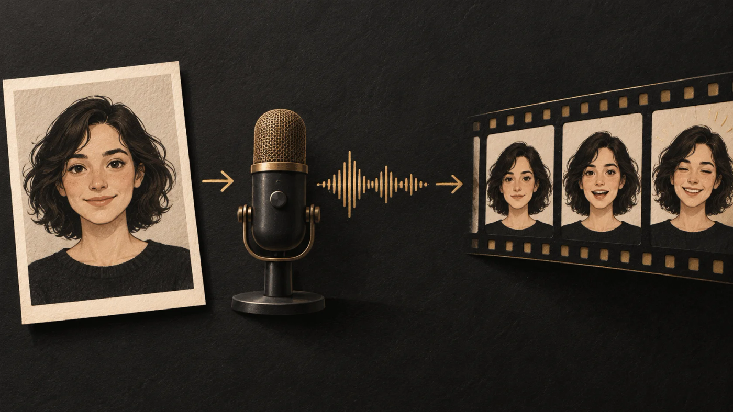
LipSyncX
A talking photo in
your own voice
A portrait and the recording you already
want to use
lipsync ai
01 / 08
Notes:
Source tutorial: https://lipsyncx.com/blog/make-photo-talk-with-your-own-audio
Original title: How to Make a Photo Talk With Your Own Audio
Author: LipSyncX Team
Source published: 2026-10-12T07:38:55.452Z
Reference links from the tutorial:
Pricing, provider features and example settings retain the source article's dated context. Consult current provider documentation and the displayed generation quote for a new job.
Cover artwork: /blog-assets/make-photo-talk-with-your-own-audio/cover.webp

Slide 2
The first input pair
Portrait
Use one clear face with visible lips and room around the head.
Recording
Choose one short sentence in your finished voice recording.
Composition
Decide whether the final clip needs a vertical or horizontal
frame.
lipsync ai
02 / 08
Notes:
Source tutorial: https://lipsyncx.com/blog/make-photo-talk-with-your-own-audio
Original title: How to Make a Photo Talk With Your Own Audio
Author: LipSyncX Team
Source published: 2026-10-12T07:38:55.452Z
Reference links from the tutorial:
Pricing, provider features and example settings retain the source article's dated context. Consult current provider documentation and the displayed generation quote for a new job.

Slide 3
The input modes
Mode | Starting point
Audio | A finished recording you want to retain
Text | Written words that need a generated voice
Record | A recording you capture for this job
lipsync ai
03 / 08
Notes:
Source tutorial: https://lipsyncx.com/blog/make-photo-talk-with-your-own-audio
Original title: How to Make a Photo Talk With Your Own Audio
Author: LipSyncX Team
Source published: 2026-10-12T07:38:55.452Z
Reference links from the tutorial:
Pricing, provider features and example settings retain the source article's dated context. Consult current provider documentation and the displayed generation quote for a new job.

Slide 4
The uploaded recording
Replace the demo
Confirm that your file, rather than a sample, is selected.
Replay
Listen for the intended words, start point and ending.
Format checks
Use a supported file and check both the upload ceiling and the
model’s duration limit.
lipsync ai
04 / 08
Notes:
Source tutorial: https://lipsyncx.com/blog/make-photo-talk-with-your-own-audio
Original title: How to Make a Photo Talk With Your Own Audio
Author: LipSyncX Team
Source published: 2026-10-12T07:38:55.452Z
Reference links from the tutorial:
Pricing, provider features and example settings retain the source article's dated context. Consult current provider documentation and the displayed generation quote for a new job.

Slide 5
The first generation quote
Duration
Count unwanted leading and trailing silence as part of the input
until trimmed.
Settings
Read the selected model, resolution and estimated credits.
Small test
Try around 5–10 seconds before extending the message.
lipsync ai
05 / 08
Notes:
Source tutorial: https://lipsyncx.com/blog/make-photo-talk-with-your-own-audio
Original title: How to Make a Photo Talk With Your Own Audio
Author: LipSyncX Team
Source published: 2026-10-12T07:38:55.452Z
Reference links from the tutorial:
Pricing, provider features and example settings retain the source article's dated context. Consult current provider documentation and the displayed generation quote for a new job.

Slide 6
The finished-video review
Moment | What to inspect
Beginning | First audible word and mouth movement
Middle | A clear consonant and a longer vowel
Pause | Plausible behavior during silence
Ending | Complete final word without an abrupt cut
Face | Lips, teeth, chin and eye stability
lipsync ai
06 / 08
Notes:
Source tutorial: https://lipsyncx.com/blog/make-photo-talk-with-your-own-audio
Original title: How to Make a Photo Talk With Your Own Audio
Author: LipSyncX Team
Source published: 2026-10-12T07:38:55.452Z
Reference links from the tutorial:
Pricing, provider features and example settings retain the source article's dated context. Consult current provider documentation and the displayed generation quote for a new job.

Slide 7
The next attempt
Keep the reference
Save the original recording and portrait beside the result.
Change one thing
Try a cleaner portrait or tighter audio separately.
Generation checks
Confirm the image is ready, the audio is selected and the
balance covers the quote.
lipsync ai
07 / 08
Notes:
Source tutorial: https://lipsyncx.com/blog/make-photo-talk-with-your-own-audio
Original title: How to Make a Photo Talk With Your Own Audio
Author: LipSyncX Team
Source published: 2026-10-12T07:38:55.452Z
Reference links from the tutorial:
Pricing, provider features and example settings retain the source article's dated context. Consult current provider documentation and the displayed generation quote for a new job.

Slide 8
Your first short test
Use one clear input and one approved recording. Check the quote,
review a short result, then decide what to make next.
lipsync ai
https://lipsyncx.com/
Original blog tutorial
https://lipsyncx.com/blog/make-photo-talk-with-your-own-audio
lipsync ai
08 / 08
Notes:
Source tutorial: https://lipsyncx.com/blog/make-photo-talk-with-your-own-audio
Original title: How to Make a Photo Talk With Your Own Audio
Author: LipSyncX Team
Source published: 2026-10-12T07:38:55.452Z
Reference links from the tutorial:
Pricing, provider features and example settings retain the source article's dated context. Consult current provider documentation and the displayed generation quote for a new job.

