Slide 1
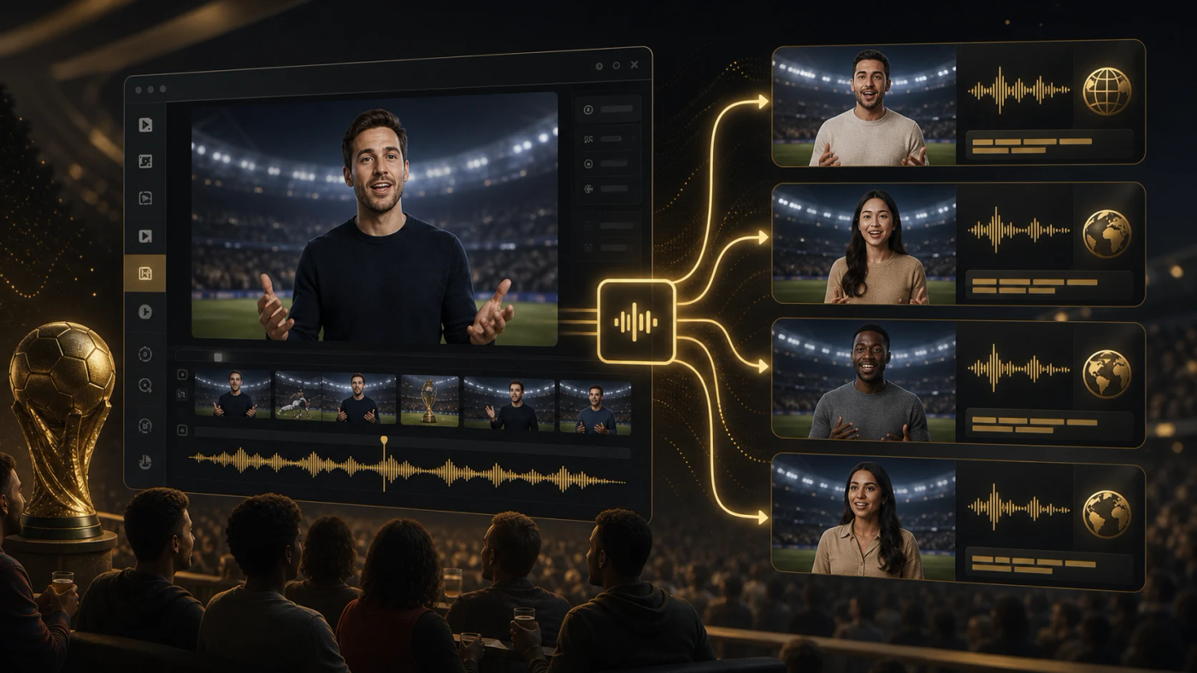
LipSyncX
Multilingual football
videos
The localization method from the 2026
World Cup tutorial
lipsync ai
01 / 08
Notes:
Source tutorial: https://lipsyncx.com/blog/multilingual-world-cup-videos-ai-dubbing
Original title: Multilingual World Cup Videos: AI Dubbing Workflow for Creators
Author: LipSyncX Team
Source published: 2026-06-17T03:22:54.555Z
Reference links from the tutorial:
https://file.lipsyncx.com/avatars/landscape/podcaster-03.jpg
Pricing, provider features and example settings retain the source article's dated context. Consult current provider documentation and the displayed generation quote for a new job.
Cover artwork: /blog-assets/multilingual-world-cup-videos-ai-dubbing/cover.webp

Slide 2
The clips that need a voice
Good candidates
A host introduction, fan reaction or tactical explainer can benefit
from native audio.
Visual-only
content
Graphics or silent highlight edits may work with captions alone.
Audience choice
Start with languages your viewers already use in comments and
analytics.
lipsync ai
02 / 08
Notes:
Source tutorial: https://lipsyncx.com/blog/multilingual-world-cup-videos-ai-dubbing
Original title: Multilingual World Cup Videos: AI Dubbing Workflow for Creators
Author: LipSyncX Team
Source published: 2026-06-17T03:22:54.555Z
Reference links from the tutorial:
https://file.lipsyncx.com/avatars/landscape/podcaster-03.jpg
Pricing, provider features and example settings retain the source article's dated context. Consult current provider documentation and the displayed generation quote for a new job.

Slide 3
The source script
Short segments
Break a dense paragraph into sentences that sound natural
aloud.
One main point
Give the match preview or venue message a specific purpose.
Final source
Approve the facts and source edit before translating.
lipsync ai
03 / 08
Notes:
Source tutorial: https://lipsyncx.com/blog/multilingual-world-cup-videos-ai-dubbing
Original title: Multilingual World Cup Videos: AI Dubbing Workflow for Creators
Author: LipSyncX Team
Source published: 2026-06-17T03:22:54.555Z
Reference links from the tutorial:
https://file.lipsyncx.com/avatars/landscape/podcaster-03.jpg
Pricing, provider features and example settings retain the source article's dated context. Consult current provider documentation and the displayed generation quote for a new job.

Slide 4
Sports idioms need adaptation
Source phrase | Localization approach
Bring the noise | Use a natural local phrase for cheering
We stole three points | Explain the tense win clearly
Derby energy | Name the rivalry or the stakes
Watch party | Use familiar local group-viewing wording
lipsync ai
04 / 08
Notes:
Source tutorial: https://lipsyncx.com/blog/multilingual-world-cup-videos-ai-dubbing
Original title: Multilingual World Cup Videos: AI Dubbing Workflow for Creators
Author: LipSyncX Team
Source published: 2026-06-17T03:22:54.555Z
Reference links from the tutorial:
https://file.lipsyncx.com/avatars/landscape/podcaster-03.jpg
Pricing, provider features and example settings retain the source article's dated context. Consult current provider documentation and the displayed generation quote for a new job.

Slide 5
The voice and visual pass
Native script
Adapt tone and rhythm for each audience rather than translating
word for word.
Voice approval
Review names, pronunciation and pacing before lip sync.
Prominent face
Add visual synchronization where the speaker stays central to
the video.
lipsync ai
05 / 08
Notes:
Source tutorial: https://lipsyncx.com/blog/multilingual-world-cup-videos-ai-dubbing
Original title: Multilingual World Cup Videos: AI Dubbing Workflow for Creators
Author: LipSyncX Team
Source published: 2026-06-17T03:22:54.555Z
Reference links from the tutorial:
https://file.lipsyncx.com/avatars/landscape/podcaster-03.jpg
Pricing, provider features and example settings retain the source article's dated context. Consult current provider documentation and the displayed generation quote for a new job.

Slide 6
Captions and platform packaging
Captions
Match the approved voice and test reading speed on mobile.
Placement
Keep text clear of the mouth and platform controls.
Publishing route
Extra audio tracks suit one unchanged picture. A localized
picture needs the appropriate video export.
lipsync ai
06 / 08
Notes:
Source tutorial: https://lipsyncx.com/blog/multilingual-world-cup-videos-ai-dubbing
Original title: Multilingual World Cup Videos: AI Dubbing Workflow for Creators
Author: LipSyncX Team
Source published: 2026-06-17T03:22:54.555Z
Reference links from the tutorial:
https://file.lipsyncx.com/avatars/landscape/podcaster-03.jpg
Pricing, provider features and example settings retain the source article's dated context. Consult current provider documentation and the displayed generation quote for a new job.

Slide 7
The final language review
Meaning
Ask a language reviewer to check sports names, idioms and
emotional tone.
Facts
Verify schedule, venue and broadcast details for the event you
are actually covering.
Context
The 2026 World Cup is the original article’s example. Avoid
implying official endorsement.
lipsync ai
07 / 08
Notes:
Source tutorial: https://lipsyncx.com/blog/multilingual-world-cup-videos-ai-dubbing
Original title: Multilingual World Cup Videos: AI Dubbing Workflow for Creators
Author: LipSyncX Team
Source published: 2026-06-17T03:22:54.555Z
Reference links from the tutorial:
https://file.lipsyncx.com/avatars/landscape/podcaster-03.jpg
Pricing, provider features and example settings retain the source article's dated context. Consult current provider documentation and the displayed generation quote for a new job.

Slide 8
Your first short test
Use one clear input and one approved recording. Check the quote,
review a short result, then decide what to make next.
lipsync ai
https://lipsyncx.com/
Original blog tutorial
https://lipsyncx.com/blog/multilingual-world-cup-videos-ai-dubbing
lipsync ai
08 / 08
Notes:
Source tutorial: https://lipsyncx.com/blog/multilingual-world-cup-videos-ai-dubbing
Original title: Multilingual World Cup Videos: AI Dubbing Workflow for Creators
Author: LipSyncX Team
Source published: 2026-06-17T03:22:54.555Z
Reference links from the tutorial:
https://file.lipsyncx.com/avatars/landscape/podcaster-03.jpg
Pricing, provider features and example settings retain the source article's dated context. Consult current provider documentation and the displayed generation quote for a new job.

