Slide 1
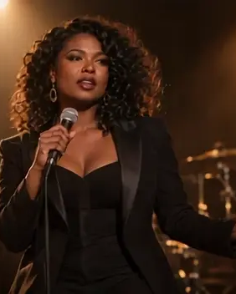
LipSyncX
Several
performance shots
from one song
Exact audio excerpts and one fixed
master timeline
lipsync ai
01 / 08
Notes:
Source tutorial: https://lipsyncx.com/blog/multiple-lip-synced-shots-own-song
Original title: Make Several Lip-Synced Performance Shots From Your Own Song
Author: LipSyncX Team
Source published: 2026-10-23T09:30:39.989Z
Reference links from the tutorial:
Pricing, provider features and example settings retain the source article's dated context. Consult current provider documentation and the displayed generation quote for a new job.
Cover artwork: /blog-assets/scenario-guides-2026-10/music-a-poster.webp

Slide 2
The fixed master audio
Final recording
Use an authorized song master and keep its timing unchanged.
Changes
Tempo, intro length or a new vocal take can break alignment
with existing renders.
Reference
Use the master as the final timeline’s audio source.
lipsync ai
02 / 08
Notes:
Source tutorial: https://lipsyncx.com/blog/multiple-lip-synced-shots-own-song
Original title: Make Several Lip-Synced Performance Shots From Your Own Song
Author: LipSyncX Team
Source published: 2026-10-23T09:30:39.989Z
Reference links from the tutorial:
Pricing, provider features and example settings retain the source article's dated context. Consult current provider documentation and the displayed generation quote for a new job.

Slide 3
A shot log before generation
File | Master start | Master end | Job
verse-a | 00:12.000 | 00:20.000 | First performance shot
chorus-a | 00:36.000 | 00:44.000 | Chorus close-up
chorus-b | 00:36.000 | 00:44.000 | Alternative take
Planning example from the article. Record any lead-in as part of the source offset.
lipsync ai
03 / 08
Notes:
Source tutorial: https://lipsyncx.com/blog/multiple-lip-synced-shots-own-song
Original title: Make Several Lip-Synced Performance Shots From Your Own Song
Author: LipSyncX Team
Source published: 2026-10-23T09:30:39.989Z
Reference links from the tutorial:
Pricing, provider features and example settings retain the source article's dated context. Consult current provider documentation and the displayed generation quote for a new job.

Slide 4
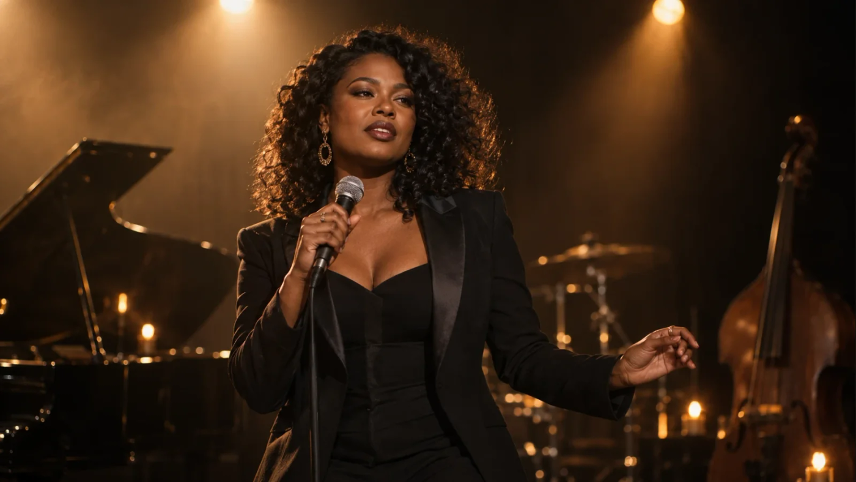
The performance source
Face
Choose a readable mouth without a microphone or
hand covering it.
Identity
Use consistent authorized images for one performer.
Alternative visuals
Unrelated portraits should be treated as different
performers.
lipsync ai
04 / 08
Notes:
Source tutorial: https://lipsyncx.com/blog/multiple-lip-synced-shots-own-song
Original title: Make Several Lip-Synced Performance Shots From Your Own Song
Author: LipSyncX Team
Source published: 2026-10-23T09:30:39.989Z
Reference links from the tutorial:
Pricing, provider features and example settings retain the source article's dated context. Consult current provider documentation and the displayed generation quote for a new job.
Image source: https://lipsyncx.com/blog-assets/scenario-guides-2026-10/music-input.webp
Images and product screenshots retain the original article's example context. Shared screenshots illustrate controls, rather than the specific example's render history.

Slide 5
The exact excerpt
Audio selection
Export the logged time range and check the first syllable.
Generation
Upload the portrait and excerpt to Make Photo Sing, then read
the quote.
Pilot
Generate a short phrase before preparing all the shots.
lipsync ai
05 / 08
Notes:
Source tutorial: https://lipsyncx.com/blog/multiple-lip-synced-shots-own-song
Original title: Make Several Lip-Synced Performance Shots From Your Own Song
Author: LipSyncX Team
Source published: 2026-10-23T09:30:39.989Z
Reference links from the tutorial:
Pricing, provider features and example settings retain the source article's dated context. Consult current provider documentation and the displayed generation quote for a new job.

Slide 6
The performance comparison
Timing
Listen for closures and vowels in the same source phrase.
Image
Inspect the full result for facial distortion and clipped endings.
Source example
The guide’s two alternative performers share an audio excerpt
starting at zero seconds.
lipsync ai
06 / 08
Notes:
Source tutorial: https://lipsyncx.com/blog/multiple-lip-synced-shots-own-song
Original title: Make Several Lip-Synced Performance Shots From Your Own Song
Author: LipSyncX Team
Source published: 2026-10-23T09:30:39.989Z
Reference links from the tutorial:
Pricing, provider features and example settings retain the source article's dated context. Consult current provider documentation and the displayed generation quote for a new job.

Slide 7
The final timeline
Placement
Put each generated clip at its logged master start time.
Duplicate audio
Use the clip audio to check alignment, then mute it to avoid an
echo.
Picture
alternatives
Replace the picture over the same range while the master stays
fixed. Avoid stretching the performance.
lipsync ai
07 / 08
Notes:
Source tutorial: https://lipsyncx.com/blog/multiple-lip-synced-shots-own-song
Original title: Make Several Lip-Synced Performance Shots From Your Own Song
Author: LipSyncX Team
Source published: 2026-10-23T09:30:39.989Z
Reference links from the tutorial:
Pricing, provider features and example settings retain the source article's dated context. Consult current provider documentation and the displayed generation quote for a new job.

Slide 8
Your first short test
Use one clear input and one approved recording. Check the quote,
review a short result, then decide what to make next.
lipsync ai
https://lipsyncx.com/
Original blog tutorial
https://lipsyncx.com/blog/multiple-lip-synced-shots-own-song
lipsync ai
08 / 08
Notes:
Source tutorial: https://lipsyncx.com/blog/multiple-lip-synced-shots-own-song
Original title: Make Several Lip-Synced Performance Shots From Your Own Song
Author: LipSyncX Team
Source published: 2026-10-23T09:30:39.989Z
Reference links from the tutorial:
Pricing, provider features and example settings retain the source article's dated context. Consult current provider documentation and the displayed generation quote for a new job.

