Slide 1
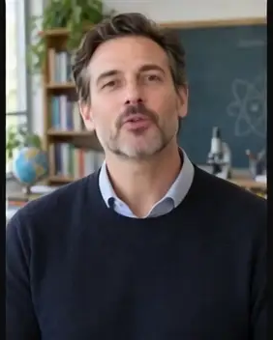
LipSyncX
A talking host for
your podcast intro
A short video teaser from an existing
introduction recording
lipsync ai
01 / 08
Notes:
Source tutorial: https://lipsyncx.com/blog/podcast-intro-talking-host-video
Original title: Turn Your Podcast Intro Audio Into a Talking Host Clip
Author: LipSyncX Team
Source published: 2026-10-23T09:30:37.746Z
Reference links from the tutorial:
Pricing, provider features and example settings retain the source article's dated context. Consult current provider documentation and the displayed generation quote for a new job.
Cover artwork: /blog-assets/scenario-guides-2026-10/podcast-poster.webp

Slide 2
The useful intro excerpt
Content
Choose a self-contained section with the show name, topic and
reason to listen.
First test
Use a 5–10 second sentence before extending the opening.
Focus
Leave long sponsor reads and housekeeping outside the first
sample.
lipsync ai
02 / 08
Notes:
Source tutorial: https://lipsyncx.com/blog/podcast-intro-talking-host-video
Original title: Turn Your Podcast Intro Audio Into a Talking Host Clip
Author: LipSyncX Team
Source published: 2026-10-23T09:30:37.746Z
Reference links from the tutorial:
Pricing, provider features and example settings retain the source article's dated context. Consult current provider documentation and the displayed generation quote for a new job.

Slide 3
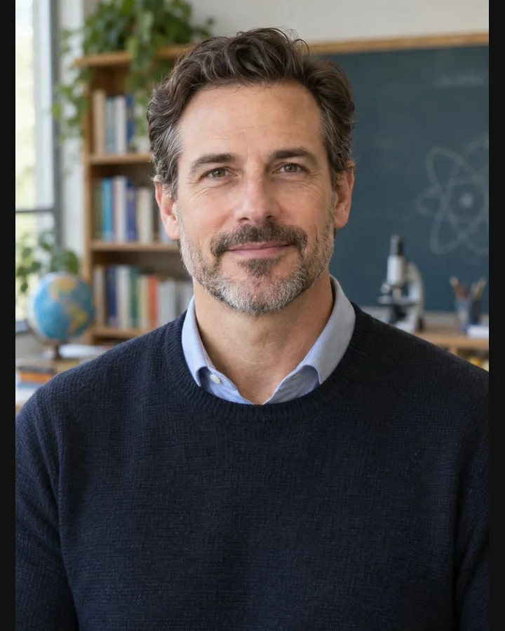
The host portrait
Permission
Use an authorized host image.
Mouth visibility
Keep microphones and props away from the lips.
Framing
Leave enough room around the head for the intended
crop.
lipsync ai
03 / 08
Notes:
Source tutorial: https://lipsyncx.com/blog/podcast-intro-talking-host-video
Original title: Turn Your Podcast Intro Audio Into a Talking Host Clip
Author: LipSyncX Team
Source published: 2026-10-23T09:30:37.746Z
Reference links from the tutorial:
Pricing, provider features and example settings retain the source article's dated context. Consult current provider documentation and the displayed generation quote for a new job.
Image source: https://lipsyncx.com/blog-assets/scenario-guides-2026-10/podcast-input.webp
Images and product screenshots retain the original article's example context. Shared screenshots illustrate controls, rather than the specific example's render history.

Slide 4
The existing voice recording
Audio mode
Upload the finished intro without rewriting it into Text mode.
Speech first
Test a speech-only excerpt if a long jingle obscures the first
words.
Music later
Add the jingle in the editor for precise timing and levels.
lipsync ai
04 / 08
Notes:
Source tutorial: https://lipsyncx.com/blog/podcast-intro-talking-host-video
Original title: Turn Your Podcast Intro Audio Into a Talking Host Clip
Author: LipSyncX Team
Source published: 2026-10-23T09:30:37.746Z
Reference links from the tutorial:
Pricing, provider features and example settings retain the source article's dated context. Consult current provider documentation and the displayed generation quote for a new job.

Slide 5
The first host render
Quote
Check the active model, resolution and estimated credits.
Names
Confirm the show title, guest names and final instruction in the
recording.
Review
Inspect consonants, sentence endings and distracting head
movement.
lipsync ai
05 / 08
Notes:
Source tutorial: https://lipsyncx.com/blog/podcast-intro-talking-host-video
Original title: Turn Your Podcast Intro Audio Into a Talking Host Clip
Author: LipSyncX Team
Source published: 2026-10-23T09:30:37.746Z
Reference links from the tutorial:
Pricing, provider features and example settings retain the source article's dated context. Consult current provider documentation and the displayed generation quote for a new job.

Slide 6
The teaser edit
Element | Question to check
Host intro | Does the topic match the excerpt?
Episode excerpt | Are speaker changes understandable?
Music | Can viewers hear the speech clearly?
End card | Are the show name and listening destination correct?
lipsync ai
06 / 08
Notes:
Source tutorial: https://lipsyncx.com/blog/podcast-intro-talking-host-video
Original title: Turn Your Podcast Intro Audio Into a Talking Host Clip
Author: LipSyncX Team
Source published: 2026-10-23T09:30:37.746Z
Reference links from the tutorial:
Pricing, provider features and example settings retain the source article's dated context. Consult current provider documentation and the displayed generation quote for a new job.

Slide 7
The final export
Alignment
Keep the approved recording aligned with the lip-synced picture.
Assembly
Add captions and cut to real interview footage or other
authorized visuals.
Scope
A talking portrait creates a host segment, rather than recovering
unrecorded interview footage.
lipsync ai
07 / 08
Notes:
Source tutorial: https://lipsyncx.com/blog/podcast-intro-talking-host-video
Original title: Turn Your Podcast Intro Audio Into a Talking Host Clip
Author: LipSyncX Team
Source published: 2026-10-23T09:30:37.746Z
Reference links from the tutorial:
Pricing, provider features and example settings retain the source article's dated context. Consult current provider documentation and the displayed generation quote for a new job.

Slide 8
Your first short test
Use one clear input and one approved recording. Check the quote,
review a short result, then decide what to make next.
lipsync ai
https://lipsyncx.com/
Original blog tutorial
https://lipsyncx.com/blog/podcast-intro-talking-host-video
lipsync ai
08 / 08
Notes:
Source tutorial: https://lipsyncx.com/blog/podcast-intro-talking-host-video
Original title: Turn Your Podcast Intro Audio Into a Talking Host Clip
Author: LipSyncX Team
Source published: 2026-10-23T09:30:37.746Z
Reference links from the tutorial:
Pricing, provider features and example settings retain the source article's dated context. Consult current provider documentation and the displayed generation quote for a new job.

