Slide 1
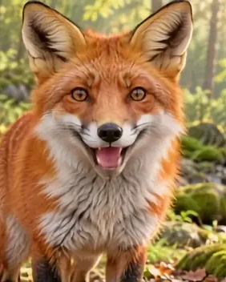
LipSyncX
A talking animal for
a short lesson
One verified fact, a clear image and a
reviewed narration
lipsync ai
01 / 08
Notes:
Source tutorial: https://lipsyncx.com/blog/talking-animal-educational-video
Original title: Make a Talking Animal Educational Video With One Verified Fact
Author: LipSyncX Team
Source published: 2026-10-23T09:30:30.956Z
Reference links from the tutorial:
https://www.nps.gov/isro/learn/nature/red-fox.htm
Pricing, provider features and example settings retain the source article's dated context. Consult current provider documentation and the displayed generation quote for a new job.
Cover artwork: /blog-assets/scenario-guides-2026-10/animal-poster.webp

Slide 2
One sourced teaching point
Fact
Choose one accurate claim and retain its authoritative source.
Example
The guide’s red fox explains what omnivore means.
Scientific scope
Keep regional observations separate from claims about every
animal of a species.
lipsync ai
02 / 08
Notes:
Source tutorial: https://lipsyncx.com/blog/talking-animal-educational-video
Original title: Make a Talking Animal Educational Video With One Verified Fact
Author: LipSyncX Team
Source published: 2026-10-23T09:30:30.956Z
Reference links from the tutorial:
https://www.nps.gov/isro/learn/nature/red-fox.htm
Pricing, provider features and example settings retain the source article's dated context. Consult current provider documentation and the displayed generation quote for a new job.

Slide 3
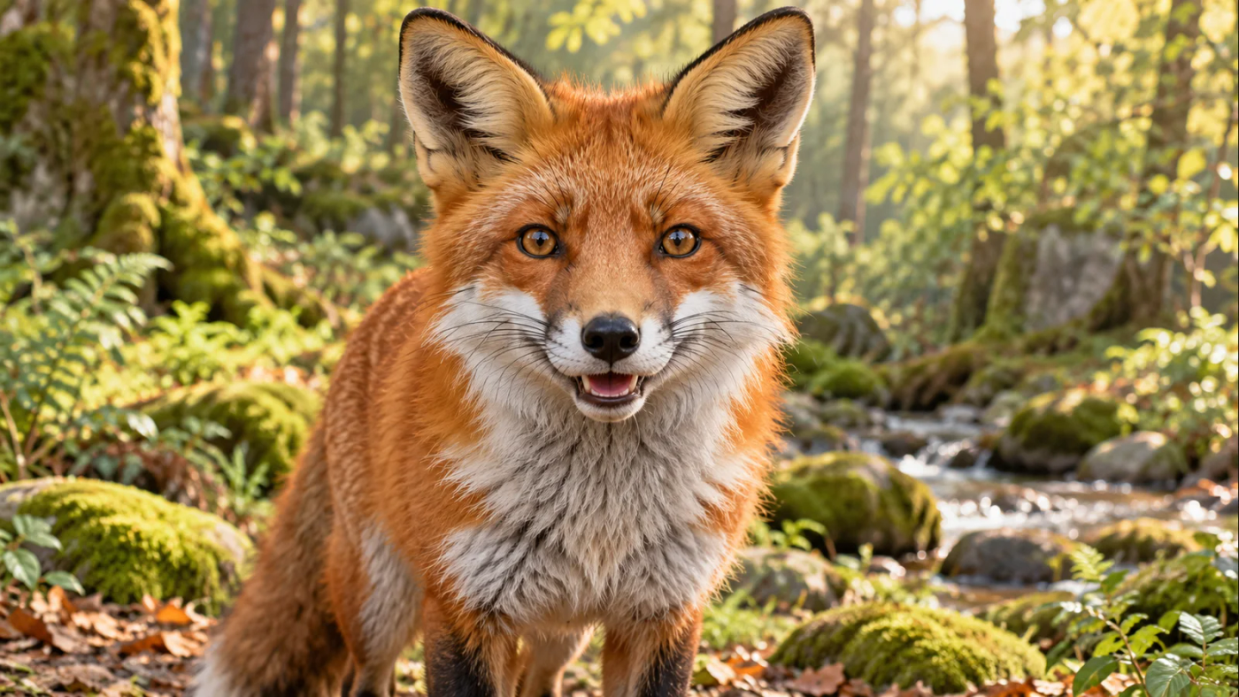
The animal image
Composition
Use a near-frontal image with a clear, unobstructed
muzzle.
Readability
Keep the animal large enough for viewers to inspect
the face.
Disclosure
Label the speaking animal as animation when sharing
it with learners.
lipsync ai
03 / 08
Notes:
Source tutorial: https://lipsyncx.com/blog/talking-animal-educational-video
Original title: Make a Talking Animal Educational Video With One Verified Fact
Author: LipSyncX Team
Source published: 2026-10-23T09:30:30.956Z
Reference links from the tutorial:
https://www.nps.gov/isro/learn/nature/red-fox.htm
Pricing, provider features and example settings retain the source article's dated context. Consult current provider documentation and the displayed generation quote for a new job.
Image source: https://lipsyncx.com/blog-assets/scenario-guides-2026-10/animal-input.webp
Images and product screenshots retain the original article's example context. Shared screenshots illustrate controls, rather than the specific example's render history.

Slide 4
The narrated explanation
Vocabulary
Use a pace that lets the intended audience follow the key term.
Approval
Correct factual errors and pronunciation before generation.
Test length
Start with a 5–10 second passage and extend after the muzzle
review.
lipsync ai
04 / 08
Notes:
Source tutorial: https://lipsyncx.com/blog/talking-animal-educational-video
Original title: Make a Talking Animal Educational Video With One Verified Fact
Author: LipSyncX Team
Source published: 2026-10-23T09:30:30.956Z
Reference links from the tutorial:
https://www.nps.gov/isro/learn/nature/red-fox.htm
Pricing, provider features and example settings retain the source article's dated context. Consult current provider documentation and the displayed generation quote for a new job.

Slide 5
The image-and-audio generation
Inputs
Open the talking-animal tool, upload the image and select Audio.
Replay
Check the full recording and trim unwanted silence.
Quote
Read the model, resolution and estimated credits before
rendering.
lipsync ai
05 / 08
Notes:
Source tutorial: https://lipsyncx.com/blog/talking-animal-educational-video
Original title: Make a Talking Animal Educational Video With One Verified Fact
Author: LipSyncX Team
Source published: 2026-10-23T09:30:30.956Z
Reference links from the tutorial:
https://www.nps.gov/isro/learn/nature/red-fox.htm
Pricing, provider features and example settings retain the source article's dated context. Consult current provider documentation and the displayed generation quote for a new job.

Slide 6
The species-specific review
Mouth
Watch timing, teeth and muzzle distortion.
Motion
Inspect unexpected head movement and sentence endings.
Limit
A successful fox sample does not establish performance for
birds, insects or every illustration style.
lipsync ai
06 / 08
Notes:
Source tutorial: https://lipsyncx.com/blog/talking-animal-educational-video
Original title: Make a Talking Animal Educational Video With One Verified Fact
Author: LipSyncX Team
Source published: 2026-10-23T09:30:30.956Z
Reference links from the tutorial:
https://www.nps.gov/isro/learn/nature/red-fox.htm
Pricing, provider features and example settings retain the source article's dated context. Consult current provider documentation and the displayed generation quote for a new job.

Slide 7
The learning activity
Context
Follow the animation with a real photograph, diagram or field
observation.
Source
Display the species name and fact reference outside the
generated frame.
Question
Ask learners which foods an omnivore might find in this habitat,
using the lesson’s evidence.
lipsync ai
07 / 08
Notes:
Source tutorial: https://lipsyncx.com/blog/talking-animal-educational-video
Original title: Make a Talking Animal Educational Video With One Verified Fact
Author: LipSyncX Team
Source published: 2026-10-23T09:30:30.956Z
Reference links from the tutorial:
https://www.nps.gov/isro/learn/nature/red-fox.htm
Pricing, provider features and example settings retain the source article's dated context. Consult current provider documentation and the displayed generation quote for a new job.

Slide 8
Your first short test
Use one clear input and one approved recording. Check the quote,
review a short result, then decide what to make next.
lipsync ai
https://lipsyncx.com/
Original blog tutorial
https://lipsyncx.com/blog/talking-animal-educational-video
lipsync ai
08 / 08
Notes:
Source tutorial: https://lipsyncx.com/blog/talking-animal-educational-video
Original title: Make a Talking Animal Educational Video With One Verified Fact
Author: LipSyncX Team
Source published: 2026-10-23T09:30:30.956Z
Reference links from the tutorial:
https://www.nps.gov/isro/learn/nature/red-fox.htm
Pricing, provider features and example settings retain the source article's dated context. Consult current provider documentation and the displayed generation quote for a new job.

