Slide 1
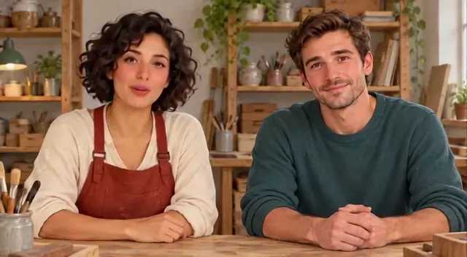
LipSyncX
A two-character
dialogue video
Clear face mapping and short, explicitly
labeled turns
lipsync ai
01 / 08
Notes:
Source tutorial: https://lipsyncx.com/blog/two-character-story-dialogue-video
Original title: Turn a Two-Character Story Scene Into a Dialogue Video
Author: LipSyncX Team
Source published: 2026-10-23T09:30:35.460Z
Reference links from the tutorial:
Pricing, provider features and example settings retain the source article's dated context. Consult current provider documentation and the displayed generation quote for a new job.
Cover artwork: /blog-assets/scenario-guides-2026-10/dialogue-poster.webp

Slide 2

Two faces in one image
Layout
Use two clear, separated faces without background
people.
Visibility
Keep both mouths free from hands and props.
Mapping
Record which character is A and which is B. In the
example, A is left and B is right.
lipsync ai
02 / 08
Notes:
Source tutorial: https://lipsyncx.com/blog/two-character-story-dialogue-video
Original title: Turn a Two-Character Story Scene Into a Dialogue Video
Author: LipSyncX Team
Source published: 2026-10-23T09:30:35.460Z
Reference links from the tutorial:
Pricing, provider features and example settings retain the source article's dated context. Consult current provider documentation and the displayed generation quote for a new job.
Image source: https://lipsyncx.com/blog-assets/scenario-guides-2026-10/dialogue-input.webp
Images and product screenshots retain the original article's example context. Shared screenshots illustrate controls, rather than the specific example's render history.

Slide 3
The short labeled exchange
A
Is the pattern ready?
B
Almost. One corner still needs work.
A, then B
Then let’s check it together. / Good idea. Small details make the
difference.
lipsync ai
03 / 08
Notes:
Source tutorial: https://lipsyncx.com/blog/two-character-story-dialogue-video
Original title: Turn a Two-Character Story Scene Into a Dialogue Video
Author: LipSyncX Team
Source published: 2026-10-23T09:30:35.460Z
Reference links from the tutorial:
Pricing, provider features and example settings retain the source article's dated context. Consult current provider documentation and the displayed generation quote for a new job.

Slide 4
The multi-dialogue controls
Studio route
Open the multi-speaker workflow and upload the two-character
image.
Voices
Assign a consistent label and voice to each person.
Input distinction
This text-and-voices workflow does not automatically separate
an existing mixed recording.
lipsync ai
04 / 08
Notes:
Source tutorial: https://lipsyncx.com/blog/two-character-story-dialogue-video
Original title: Turn a Two-Character Story Scene Into a Dialogue Video
Author: LipSyncX Team
Source published: 2026-10-23T09:30:35.460Z
Reference links from the tutorial:
Pricing, provider features and example settings retain the source article's dated context. Consult current provider documentation and the displayed generation quote for a new job.

Slide 5
The first exchange test
Small scope
Start with two turns before generating the whole scene.
Quote
Check the active model, resolution and cost estimate.
Spoken text
Keep stage directions out of dialogue unless the selected
controls explicitly support them.
lipsync ai
05 / 08
Notes:
Source tutorial: https://lipsyncx.com/blog/two-character-story-dialogue-video
Original title: Turn a Two-Character Story Scene Into a Dialogue Video
Author: LipSyncX Team
Source published: 2026-10-23T09:30:35.460Z
Reference links from the tutorial:
Pricing, provider features and example settings retain the source article's dated context. Consult current provider documentation and the displayed generation quote for a new job.

Slide 6
The turn-by-turn review
Correct face
A’s lines should animate the assigned face. Check B separately.
Listening face
Watch for unwanted mouth movement while the other person
speaks.
Transitions
Check clipped words, identity, clothing and the background
between turns.
lipsync ai
06 / 08
Notes:
Source tutorial: https://lipsyncx.com/blog/two-character-story-dialogue-video
Original title: Turn a Two-Character Story Scene Into a Dialogue Video
Author: LipSyncX Team
Source published: 2026-10-23T09:30:35.460Z
Reference links from the tutorial:
Pricing, provider features and example settings retain the source article's dated context. Consult current provider documentation and the displayed generation quote for a new job.

Slide 7
The scene inside a story
Edit
Add captions, cutaways and shot changes in the editor.
Archive
Keep the image, labeled script, voice choices and accepted MP4
together.
New scene
Update the face mapping when characters change sides. A
generated clip is a prerecorded scene segment.
lipsync ai
07 / 08
Notes:
Source tutorial: https://lipsyncx.com/blog/two-character-story-dialogue-video
Original title: Turn a Two-Character Story Scene Into a Dialogue Video
Author: LipSyncX Team
Source published: 2026-10-23T09:30:35.460Z
Reference links from the tutorial:
Pricing, provider features and example settings retain the source article's dated context. Consult current provider documentation and the displayed generation quote for a new job.

Slide 8
Your first short test
Use one clear input and one approved recording. Check the quote,
review a short result, then decide what to make next.
lipsync ai
https://lipsyncx.com/
Original blog tutorial
https://lipsyncx.com/blog/two-character-story-dialogue-video
lipsync ai
08 / 08
Notes:
Source tutorial: https://lipsyncx.com/blog/two-character-story-dialogue-video
Original title: Turn a Two-Character Story Scene Into a Dialogue Video
Author: LipSyncX Team
Source published: 2026-10-23T09:30:35.460Z
Reference links from the tutorial:
Pricing, provider features and example settings retain the source article's dated context. Consult current provider documentation and the displayed generation quote for a new job.

