Slide 1
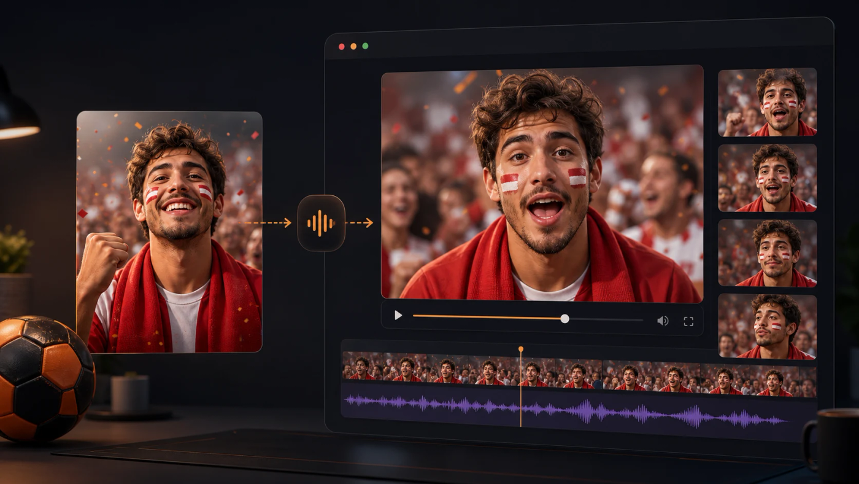
LipSyncX
An AI lip-sync fan
video
A short football message using the 2026
World Cup example
lipsync ai
01 / 08
Notes:
Source tutorial: https://lipsyncx.com/blog/world-cup-fan-video-maker-ai-lip-sync
Original title: World Cup Fan Video Maker: Create AI Lip Sync Fan Clips in 2026
Author: LipSyncX Team
Source published: 2026-06-17T03:23:05.963Z
Reference links from the tutorial:
https://file.lipsyncx.com/avatars/landscape/host-04.jpg
Pricing, provider features and example settings retain the source article's dated context. Consult current provider documentation and the displayed generation quote for a new job.
Cover artwork: /blog-assets/world-cup-fan-video-maker-ai-lip-sync/cover.webp

Slide 2
One fan message
Purpose
Choose an invite, prediction, team shoutout or post-match
reaction.
Audience
Name the specific community or viewer group.
Length
The article suggests about 10–25 seconds for a focused social
clip.
lipsync ai
02 / 08
Notes:
Source tutorial: https://lipsyncx.com/blog/world-cup-fan-video-maker-ai-lip-sync
Original title: World Cup Fan Video Maker: Create AI Lip Sync Fan Clips in 2026
Author: LipSyncX Team
Source published: 2026-06-17T03:23:05.963Z
Reference links from the tutorial:
https://file.lipsyncx.com/avatars/landscape/host-04.jpg
Pricing, provider features and example settings retain the source article's dated context. Consult current provider documentation and the displayed generation quote for a new job.

Slide 3
The source materials
Image
Use a clear authorized portrait, mascot or fan avatar.
Script
Write natural spoken sentences and read them aloud.
Facts
Verify any venue, kickoff time or offer for the event you are
covering.
lipsync ai
03 / 08
Notes:
Source tutorial: https://lipsyncx.com/blog/world-cup-fan-video-maker-ai-lip-sync
Original title: World Cup Fan Video Maker: Create AI Lip Sync Fan Clips in 2026
Author: LipSyncX Team
Source published: 2026-06-17T03:23:05.963Z
Reference links from the tutorial:
https://file.lipsyncx.com/avatars/landscape/host-04.jpg
Pricing, provider features and example settings retain the source article's dated context. Consult current provider documentation and the displayed generation quote for a new job.

Slide 4
The fan-clip generation
Final words
Finish the script and pronunciation before synchronization.
Inputs
Choose the appropriate image or video route and load the
intended voice.
Pilot
Check the generation quote and test a short section.
lipsync ai
04 / 08
Notes:
Source tutorial: https://lipsyncx.com/blog/world-cup-fan-video-maker-ai-lip-sync
Original title: World Cup Fan Video Maker: Create AI Lip Sync Fan Clips in 2026
Author: LipSyncX Team
Source published: 2026-06-17T03:23:05.963Z
Reference links from the tutorial:
https://file.lipsyncx.com/avatars/landscape/host-04.jpg
Pricing, provider features and example settings retain the source article's dated context. Consult current provider documentation and the displayed generation quote for a new job.

Slide 5
Four reusable script angles
Angle | Content to include
Watch-party invite | Venue, time and one invitation
Prediction | One opinion and a reason
After a win | A specific moment worth celebrating
After a loss | A supportive line suited to the result
lipsync ai
05 / 08
Notes:
Source tutorial: https://lipsyncx.com/blog/world-cup-fan-video-maker-ai-lip-sync
Original title: World Cup Fan Video Maker: Create AI Lip Sync Fan Clips in 2026
Author: LipSyncX Team
Source published: 2026-06-17T03:23:05.963Z
Reference links from the tutorial:
https://file.lipsyncx.com/avatars/landscape/host-04.jpg
Pricing, provider features and example settings retain the source article's dated context. Consult current provider documentation and the displayed generation quote for a new job.

Slide 6
The social-video review
Face and voice
Check mouth timing, stable facial details and emotional fit.
Captions
Keep text readable without covering the mouth.
Frame
Review the intended platform ratio and mobile layout.
lipsync ai
06 / 08
Notes:
Source tutorial: https://lipsyncx.com/blog/world-cup-fan-video-maker-ai-lip-sync
Original title: World Cup Fan Video Maker: Create AI Lip Sync Fan Clips in 2026
Author: LipSyncX Team
Source published: 2026-06-17T03:23:05.963Z
Reference links from the tutorial:
https://file.lipsyncx.com/avatars/landscape/host-04.jpg
Pricing, provider features and example settings retain the source article's dated context. Consult current provider documentation and the displayed generation quote for a new job.

Slide 7
The publishing context
Timeliness
Match the message to the current event rather than reusing
expired schedule details.
Branding
Use only authorized logos, likenesses and voices. Avoid
implying an official affiliation.
Source example
The original article’s 2026 World Cup context is historical. Adapt
the workflow for your next match.
lipsync ai
07 / 08
Notes:
Source tutorial: https://lipsyncx.com/blog/world-cup-fan-video-maker-ai-lip-sync
Original title: World Cup Fan Video Maker: Create AI Lip Sync Fan Clips in 2026
Author: LipSyncX Team
Source published: 2026-06-17T03:23:05.963Z
Reference links from the tutorial:
https://file.lipsyncx.com/avatars/landscape/host-04.jpg
Pricing, provider features and example settings retain the source article's dated context. Consult current provider documentation and the displayed generation quote for a new job.

Slide 8
Your first short test
Use one clear input and one approved recording. Check the quote,
review a short result, then decide what to make next.
lipsync ai
https://lipsyncx.com/
Original blog tutorial
https://lipsyncx.com/blog/world-cup-fan-video-maker-ai-lip-sync
lipsync ai
08 / 08
Notes:
Source tutorial: https://lipsyncx.com/blog/world-cup-fan-video-maker-ai-lip-sync
Original title: World Cup Fan Video Maker: Create AI Lip Sync Fan Clips in 2026
Author: LipSyncX Team
Source published: 2026-06-17T03:23:05.963Z
Reference links from the tutorial:
https://file.lipsyncx.com/avatars/landscape/host-04.jpg
Pricing, provider features and example settings retain the source article's dated context. Consult current provider documentation and the displayed generation quote for a new job.

